Slide 1
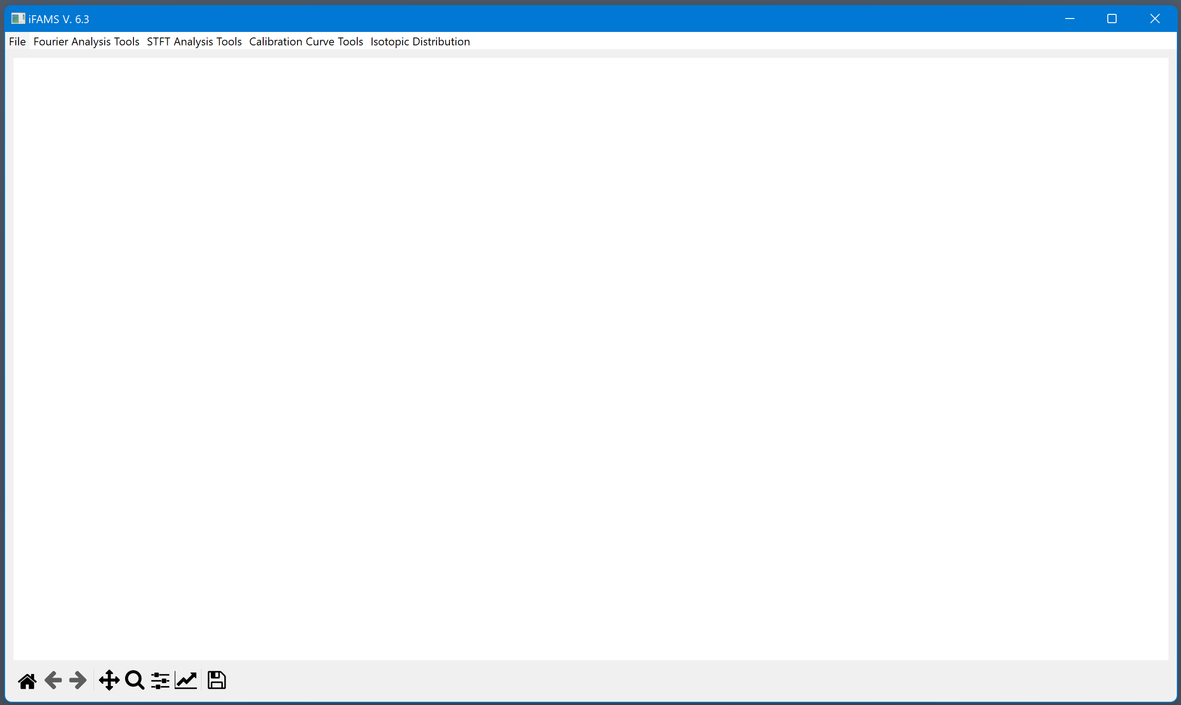
iFAMS v. 6.3 Quant Demo

Slide 2
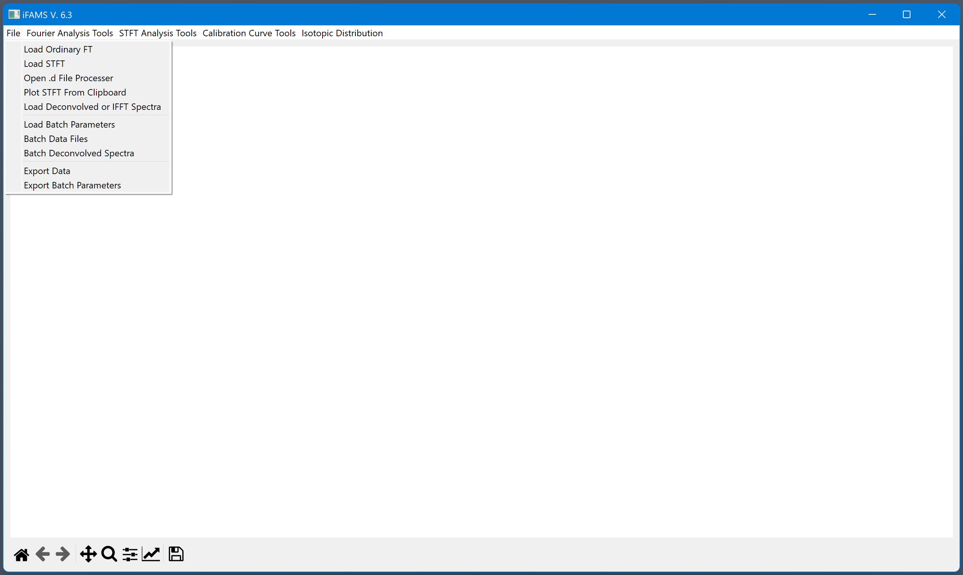
Note: Keep GUI file/executable in the same location as the “iFAMS Fun” folder

Slide 3
Load in MS data as .csv or .txt
Displays chromatogram for extracting MS data across a retention time window (only available in Quant+)
Loads processed spectra and displays additional saved content if processed from iFAMS v6.3
Loads in processing settings from a “batch_params” file
Uses stored processing settings to deconvolve set of MS files or .d files
Saves recent deconvolved spectrum and integrated peaklist
Saves processing settings to a “batch_params” file

Slide 4
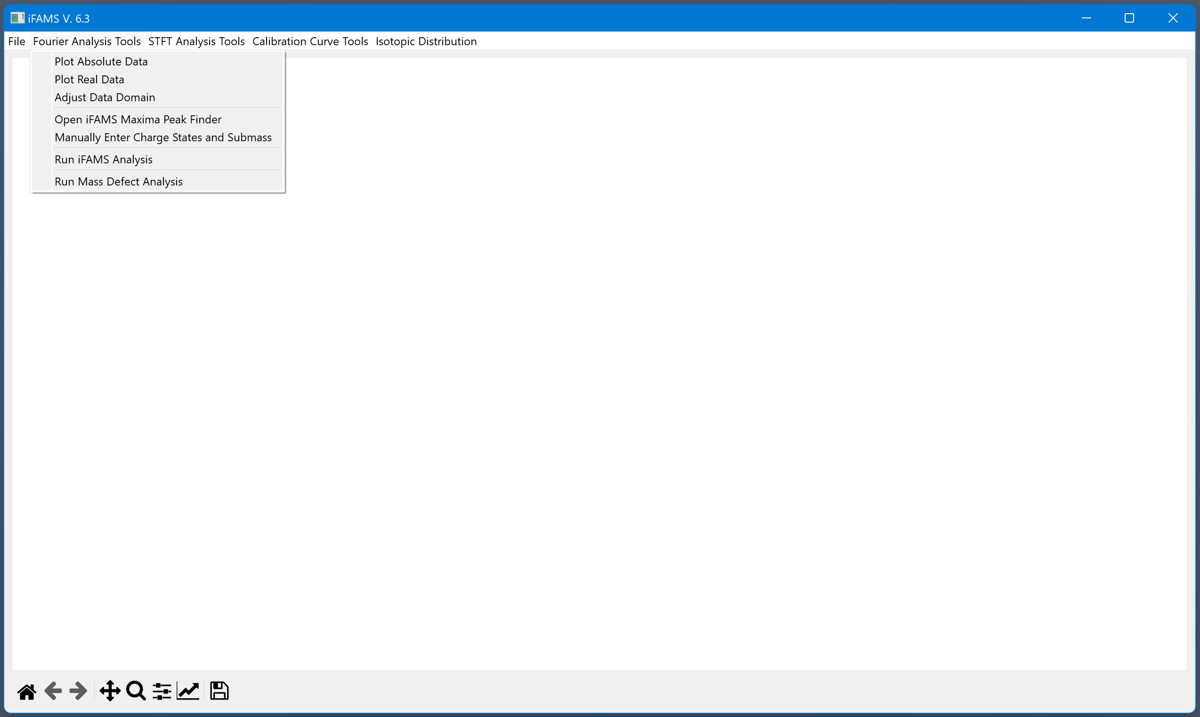
Tools for deconvolving a spectrum using ordinary FT

Slide 5
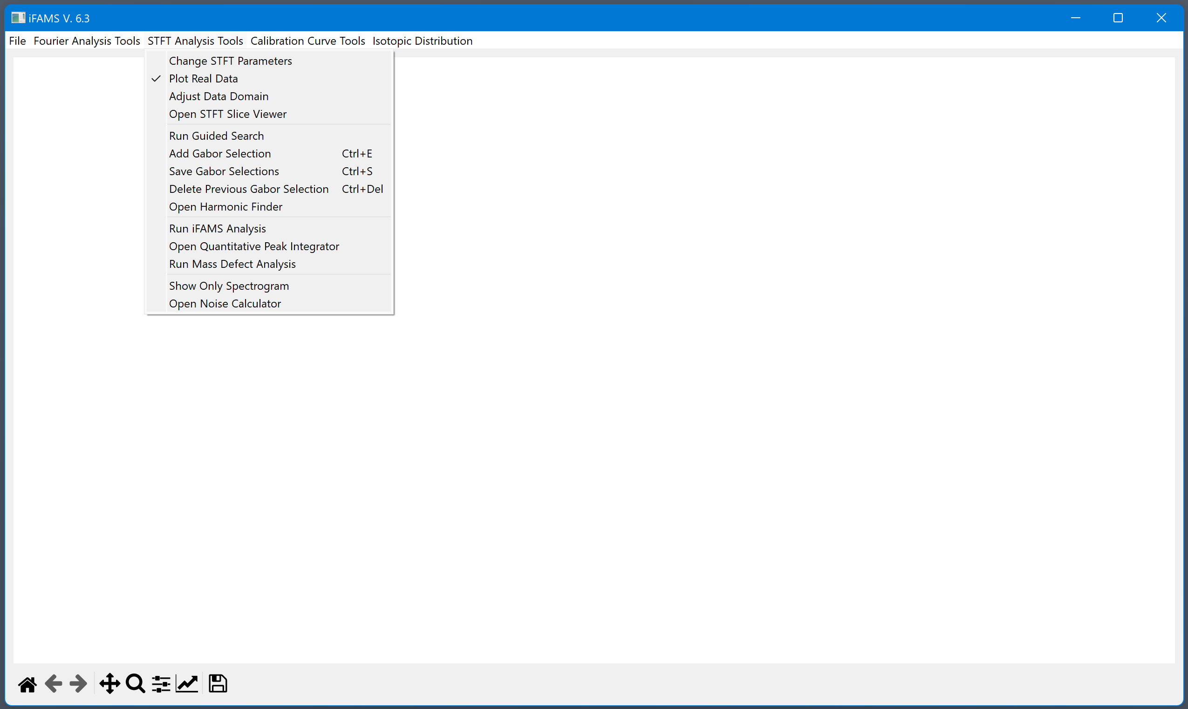
Tools for deconvolving a spectrum using STFT which includes the Gabor spectrogram

Slide 6
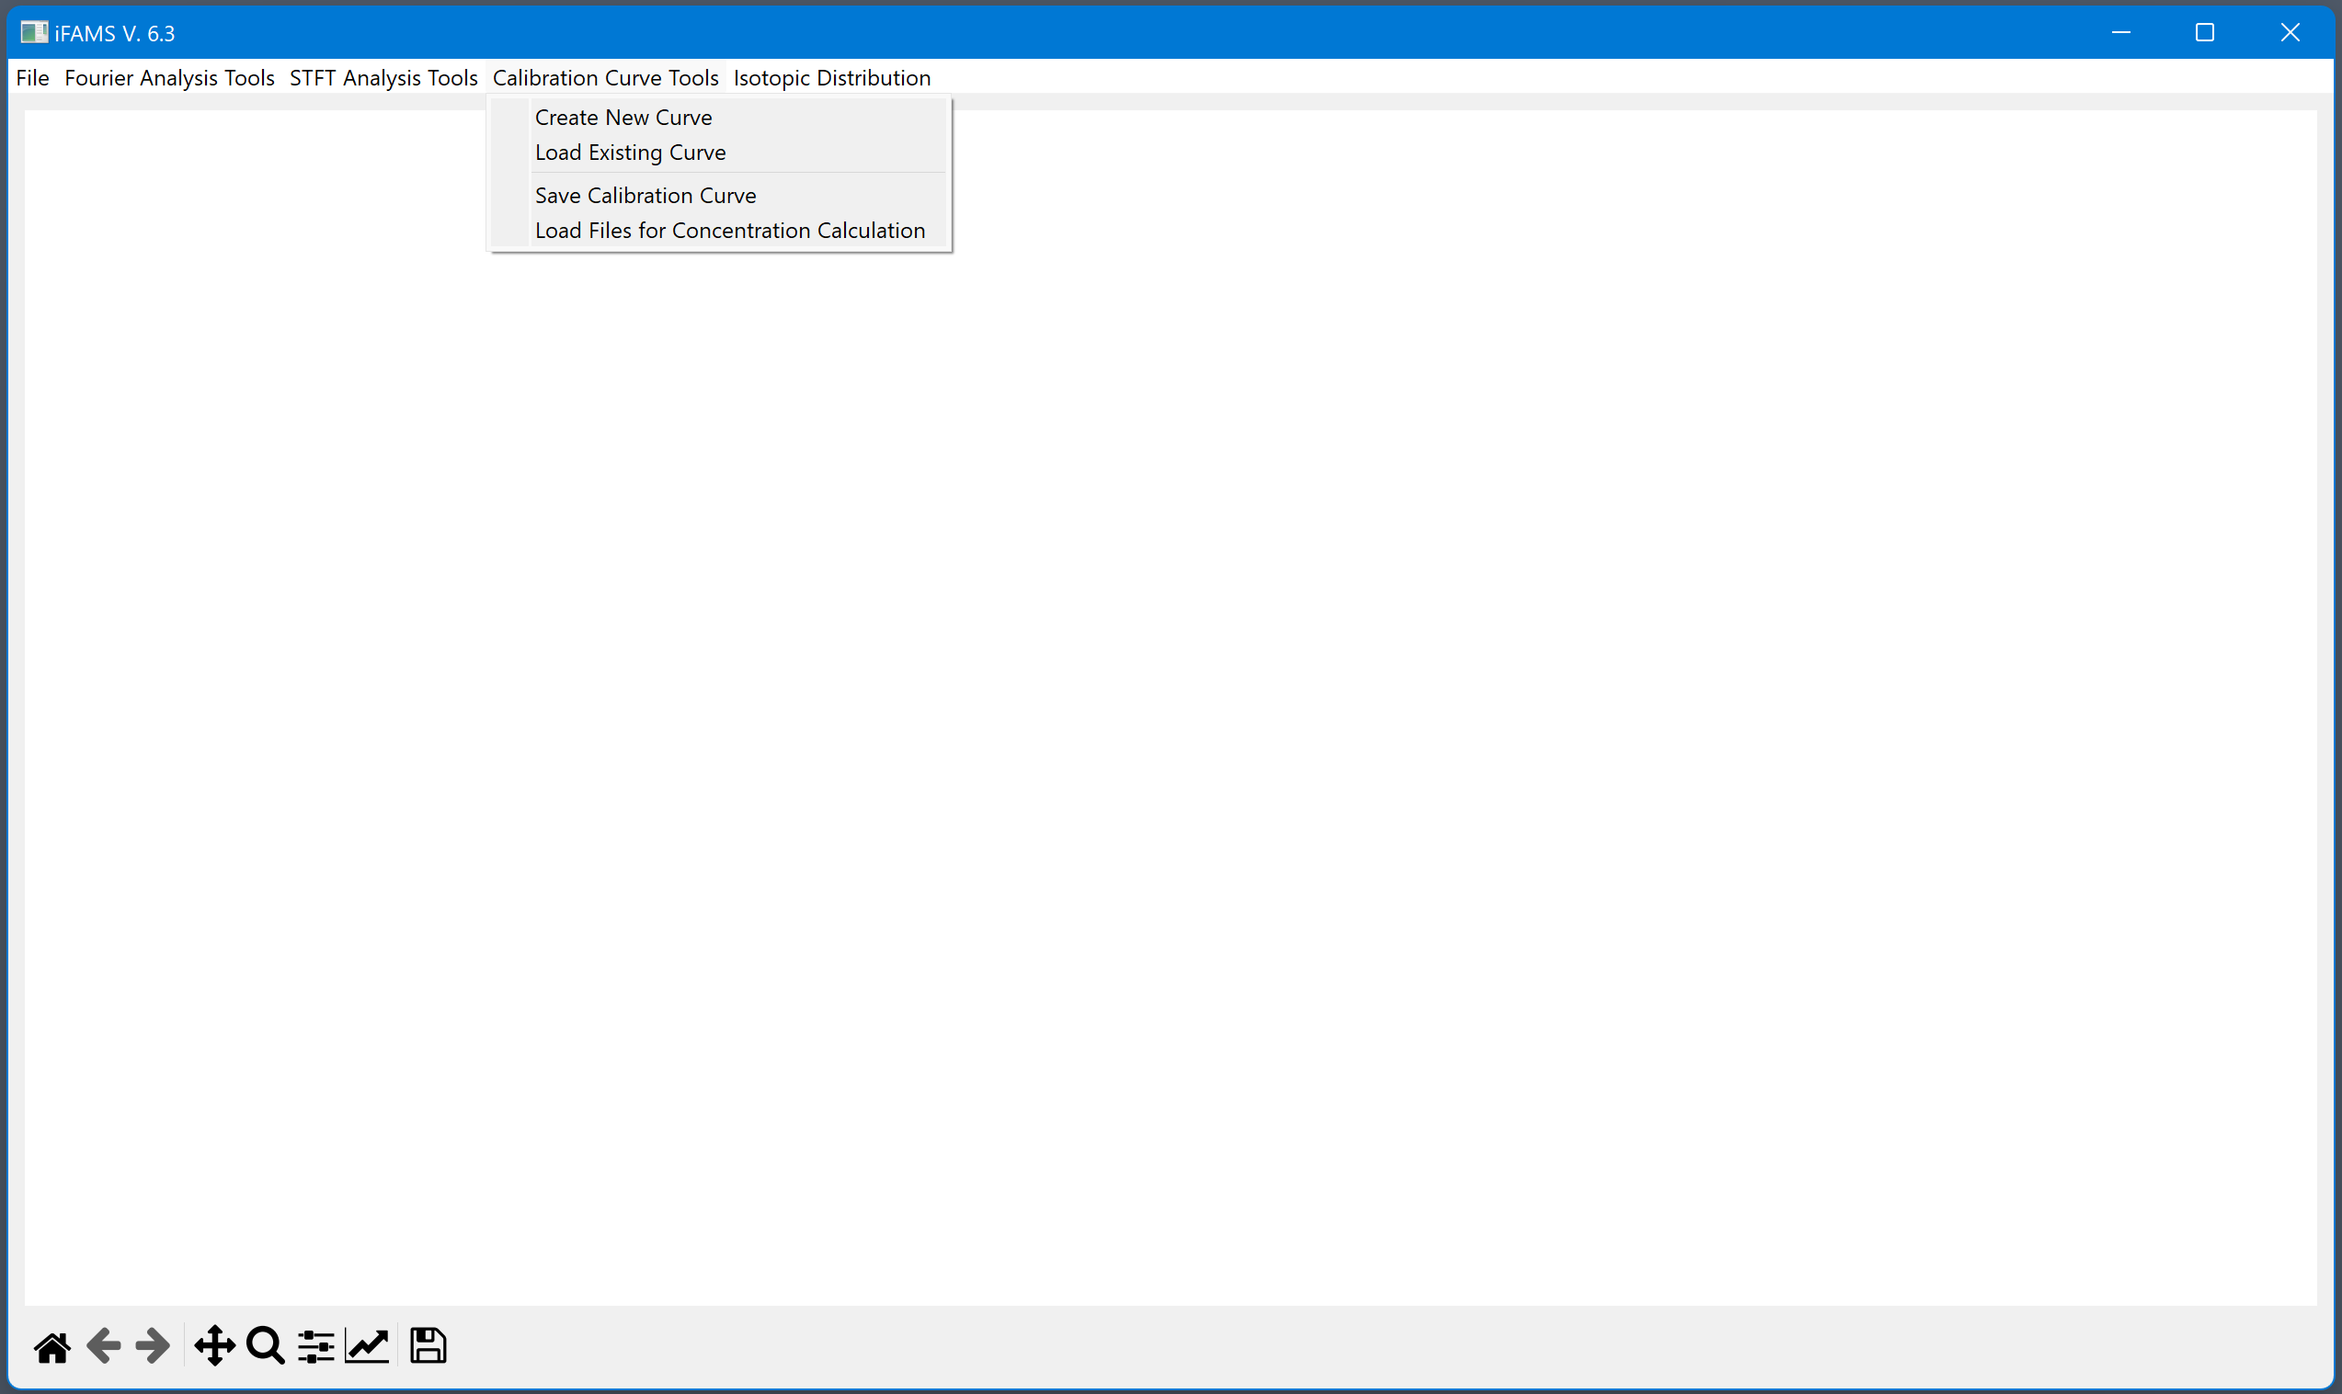
Menu for generating calibration curves

Slide 7
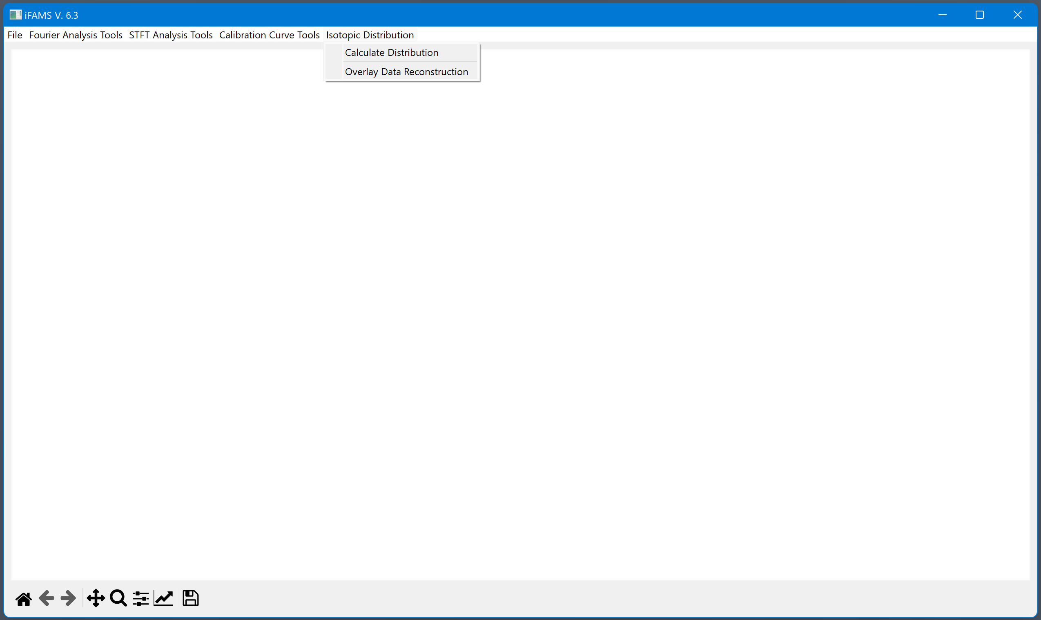
Isotope calculator for checking deconvolution against a theoretical mass distribution based on the analyte’s sequence

Slide 8
Zoom tool is quite handy for finding signal in the spectrogram. Remember to deselect Zoom to resume drawing boxes on the spectrogram for selecting signal.
These two options can help with replotting spectra within the iFAMS windows.
Saves the iFAMS screen as a PNG, EPS, etc.

Slide 9
To load a Text or CSV file of MS data for deconvolution and quantitation

Slide 10
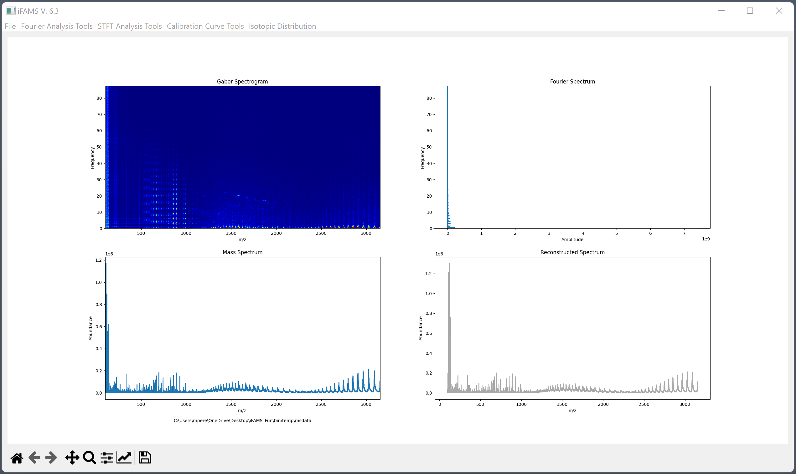
Processed as STFT…
NIST mAb signal
BSA signal

Slide 11
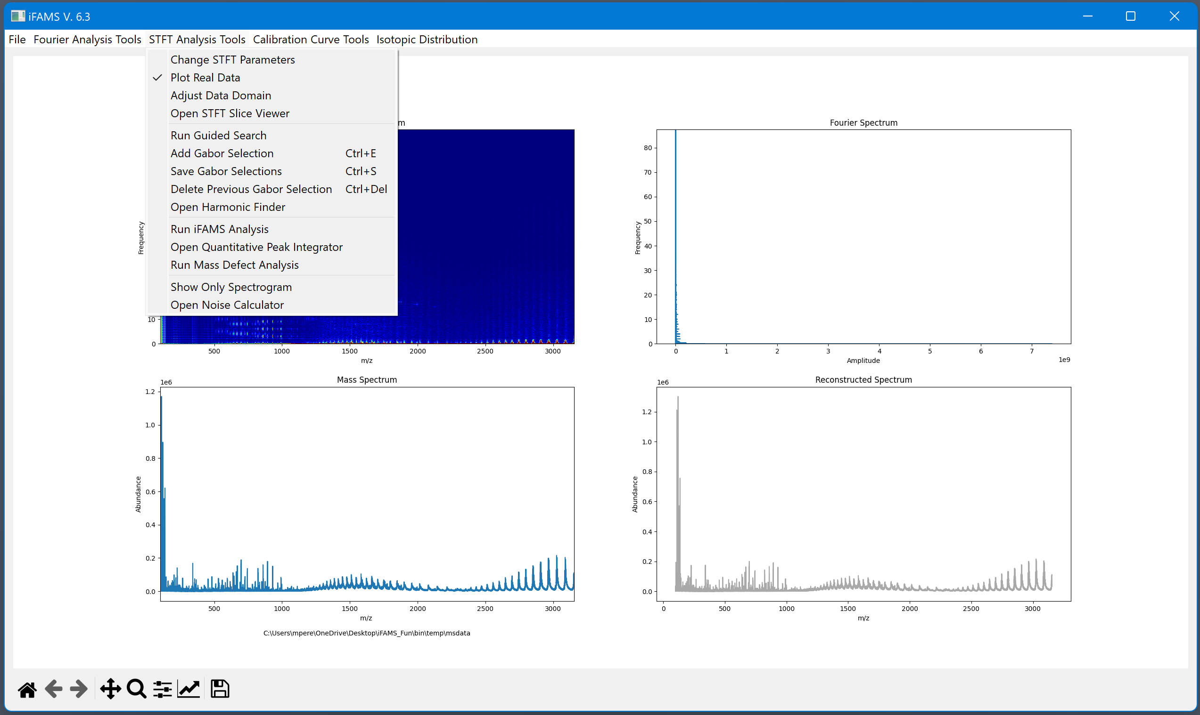
Adjusting the data domain can help focus the search

Slide 12
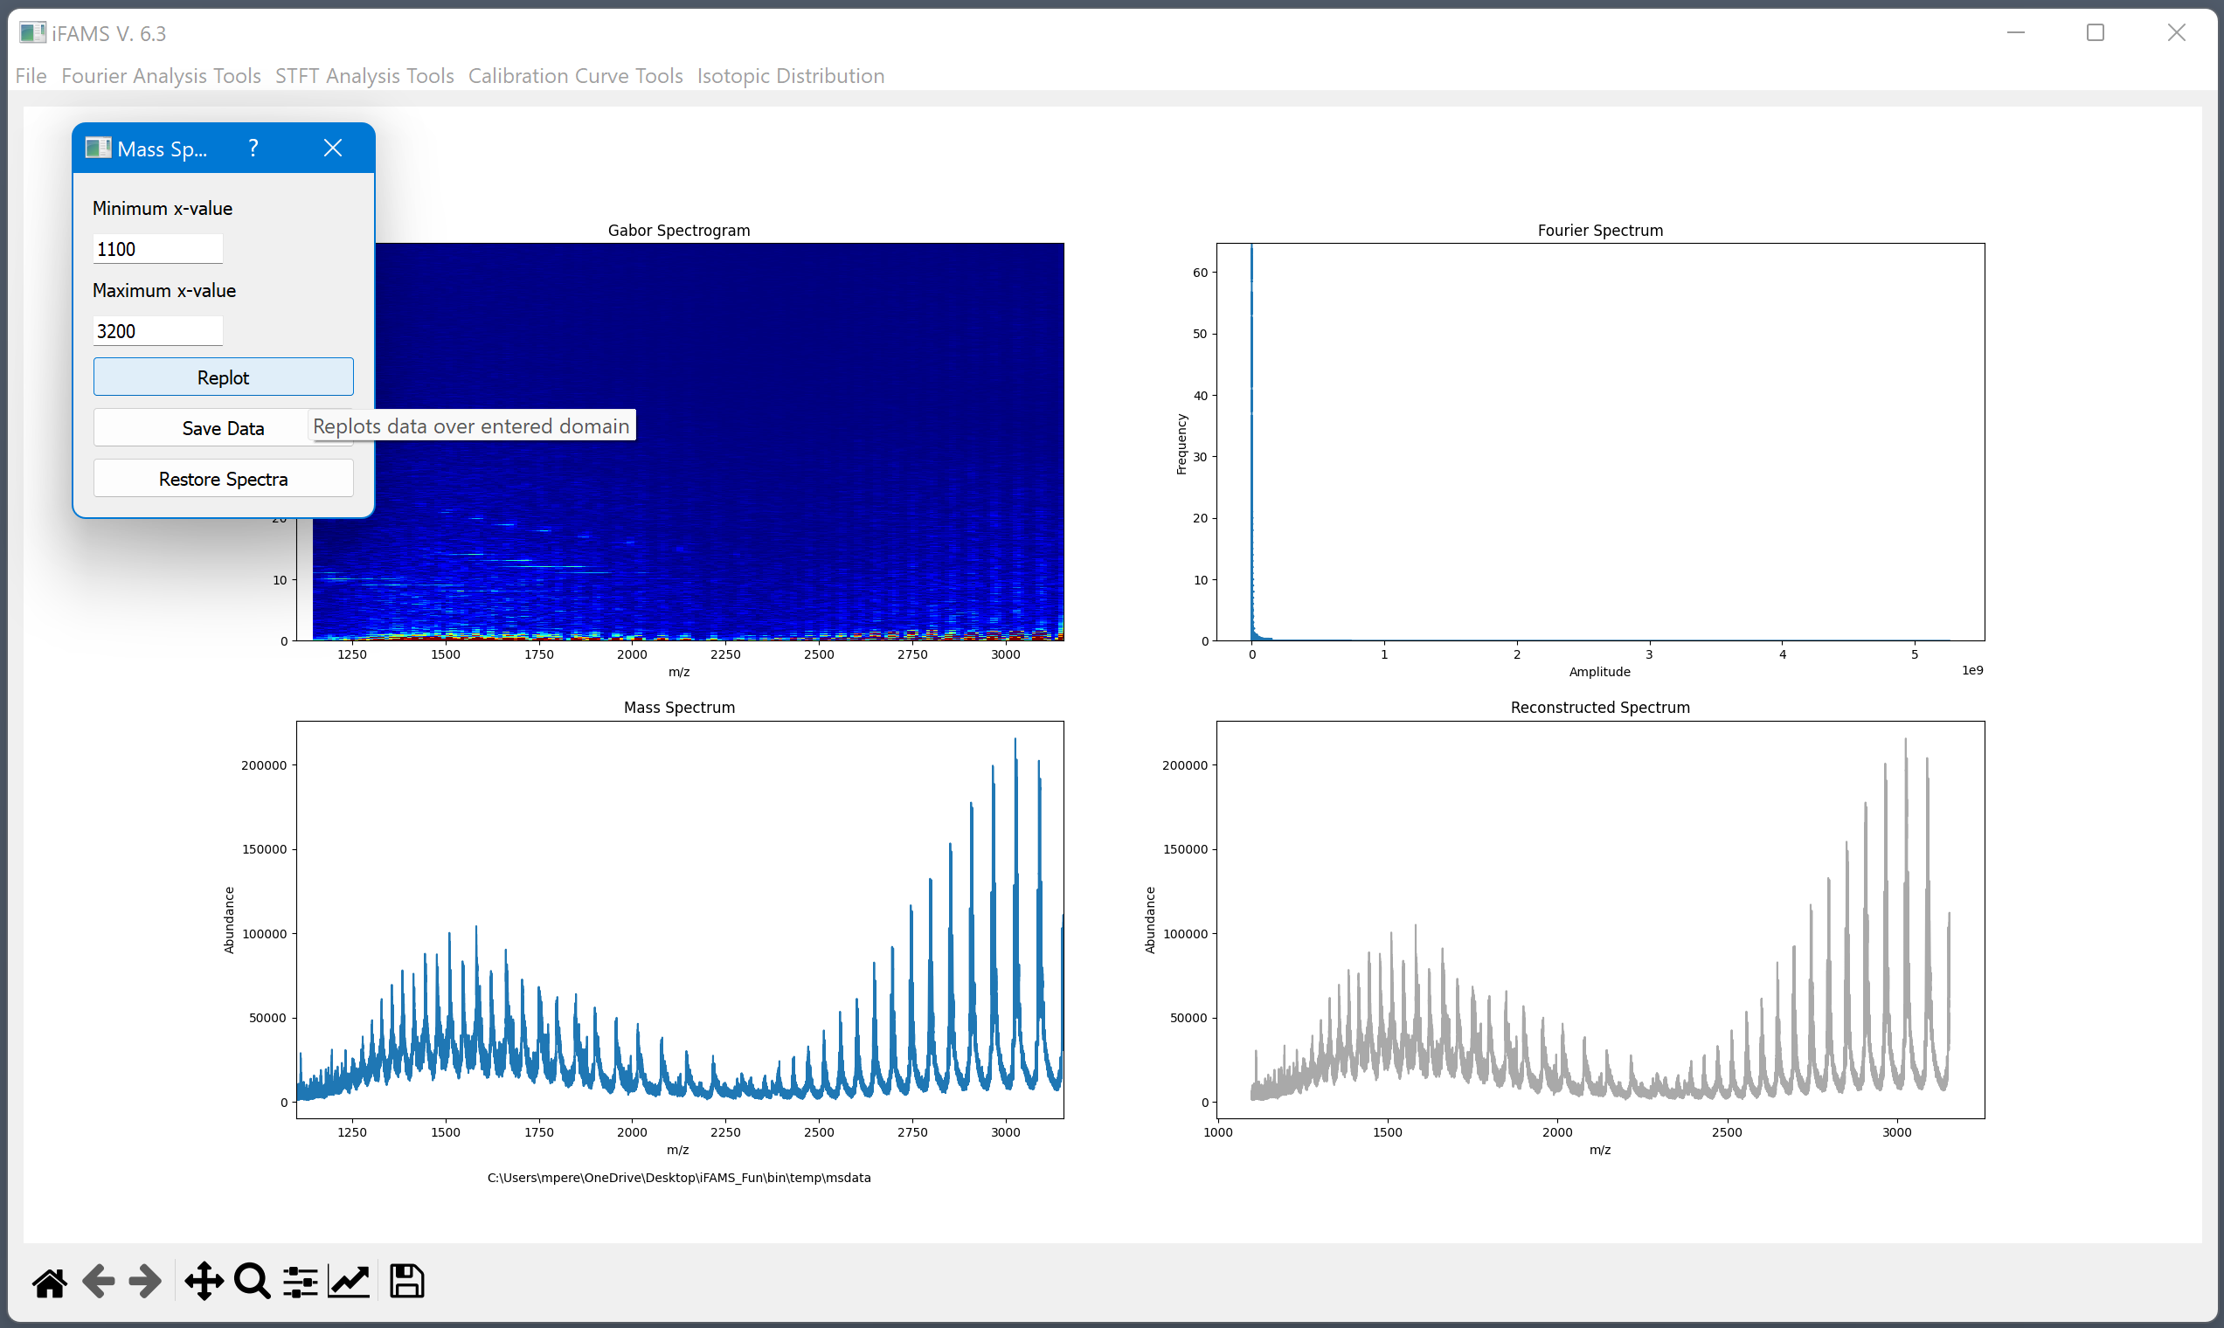
After replotting over the new domain, close out the dialog box
The new domain is stored and exported with batch parameters
Replots all spectra with the original MS domain
Saves a copy of the truncated MS data as a CSV

Slide 13
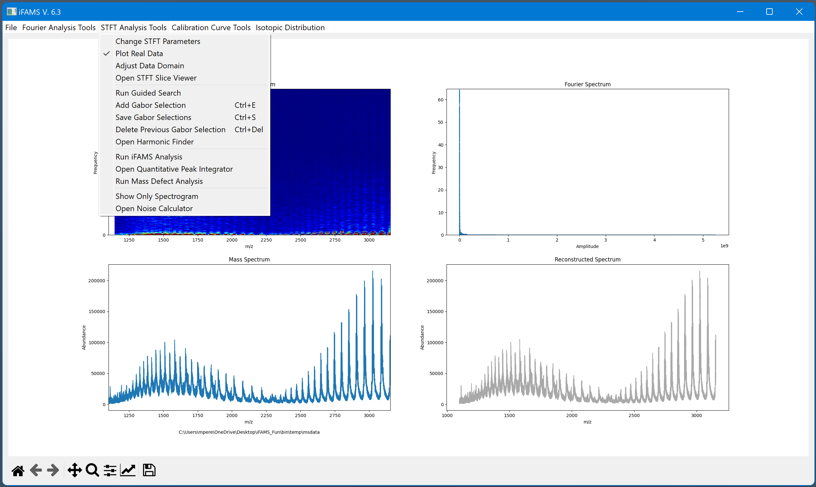
Adjusting the STFT parameters can improve signal isolation

Slide 14
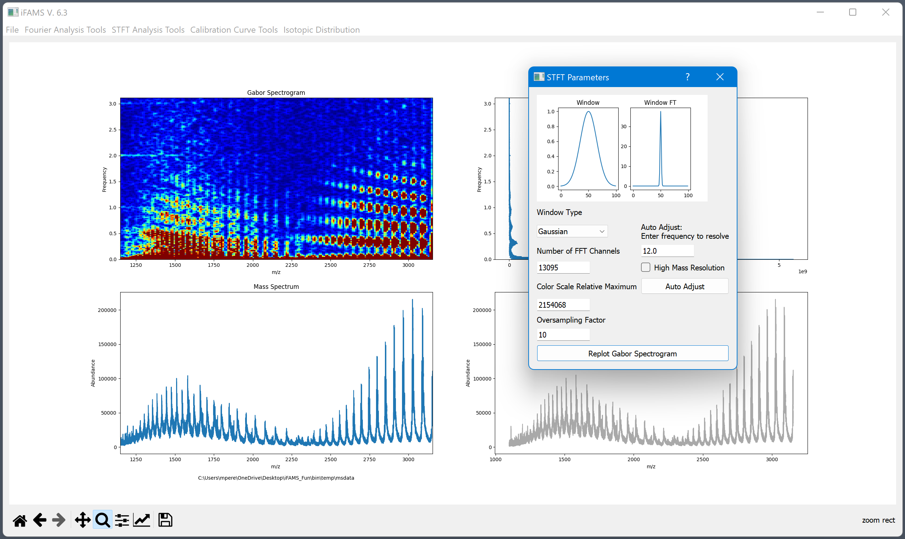
Automatic STFT adjustment tools
STFT parameters for manual adjustment

Slide 15
Determines pixel dimensions in spectrogram.
A higher number results in flatter and wider pixels (higher frequency resolution)
A lower number results in taller and narrower pixels (higher mass resolution)
Adjusts heat map scale for visualization.
Lower values will dilate red features
Higher values will constrict red features
Determines the number of pixels. The default is ten times the number of data points. Higher values increase the number of pixels which results in a “smoothing” effect on the spectrogram

Slide 16
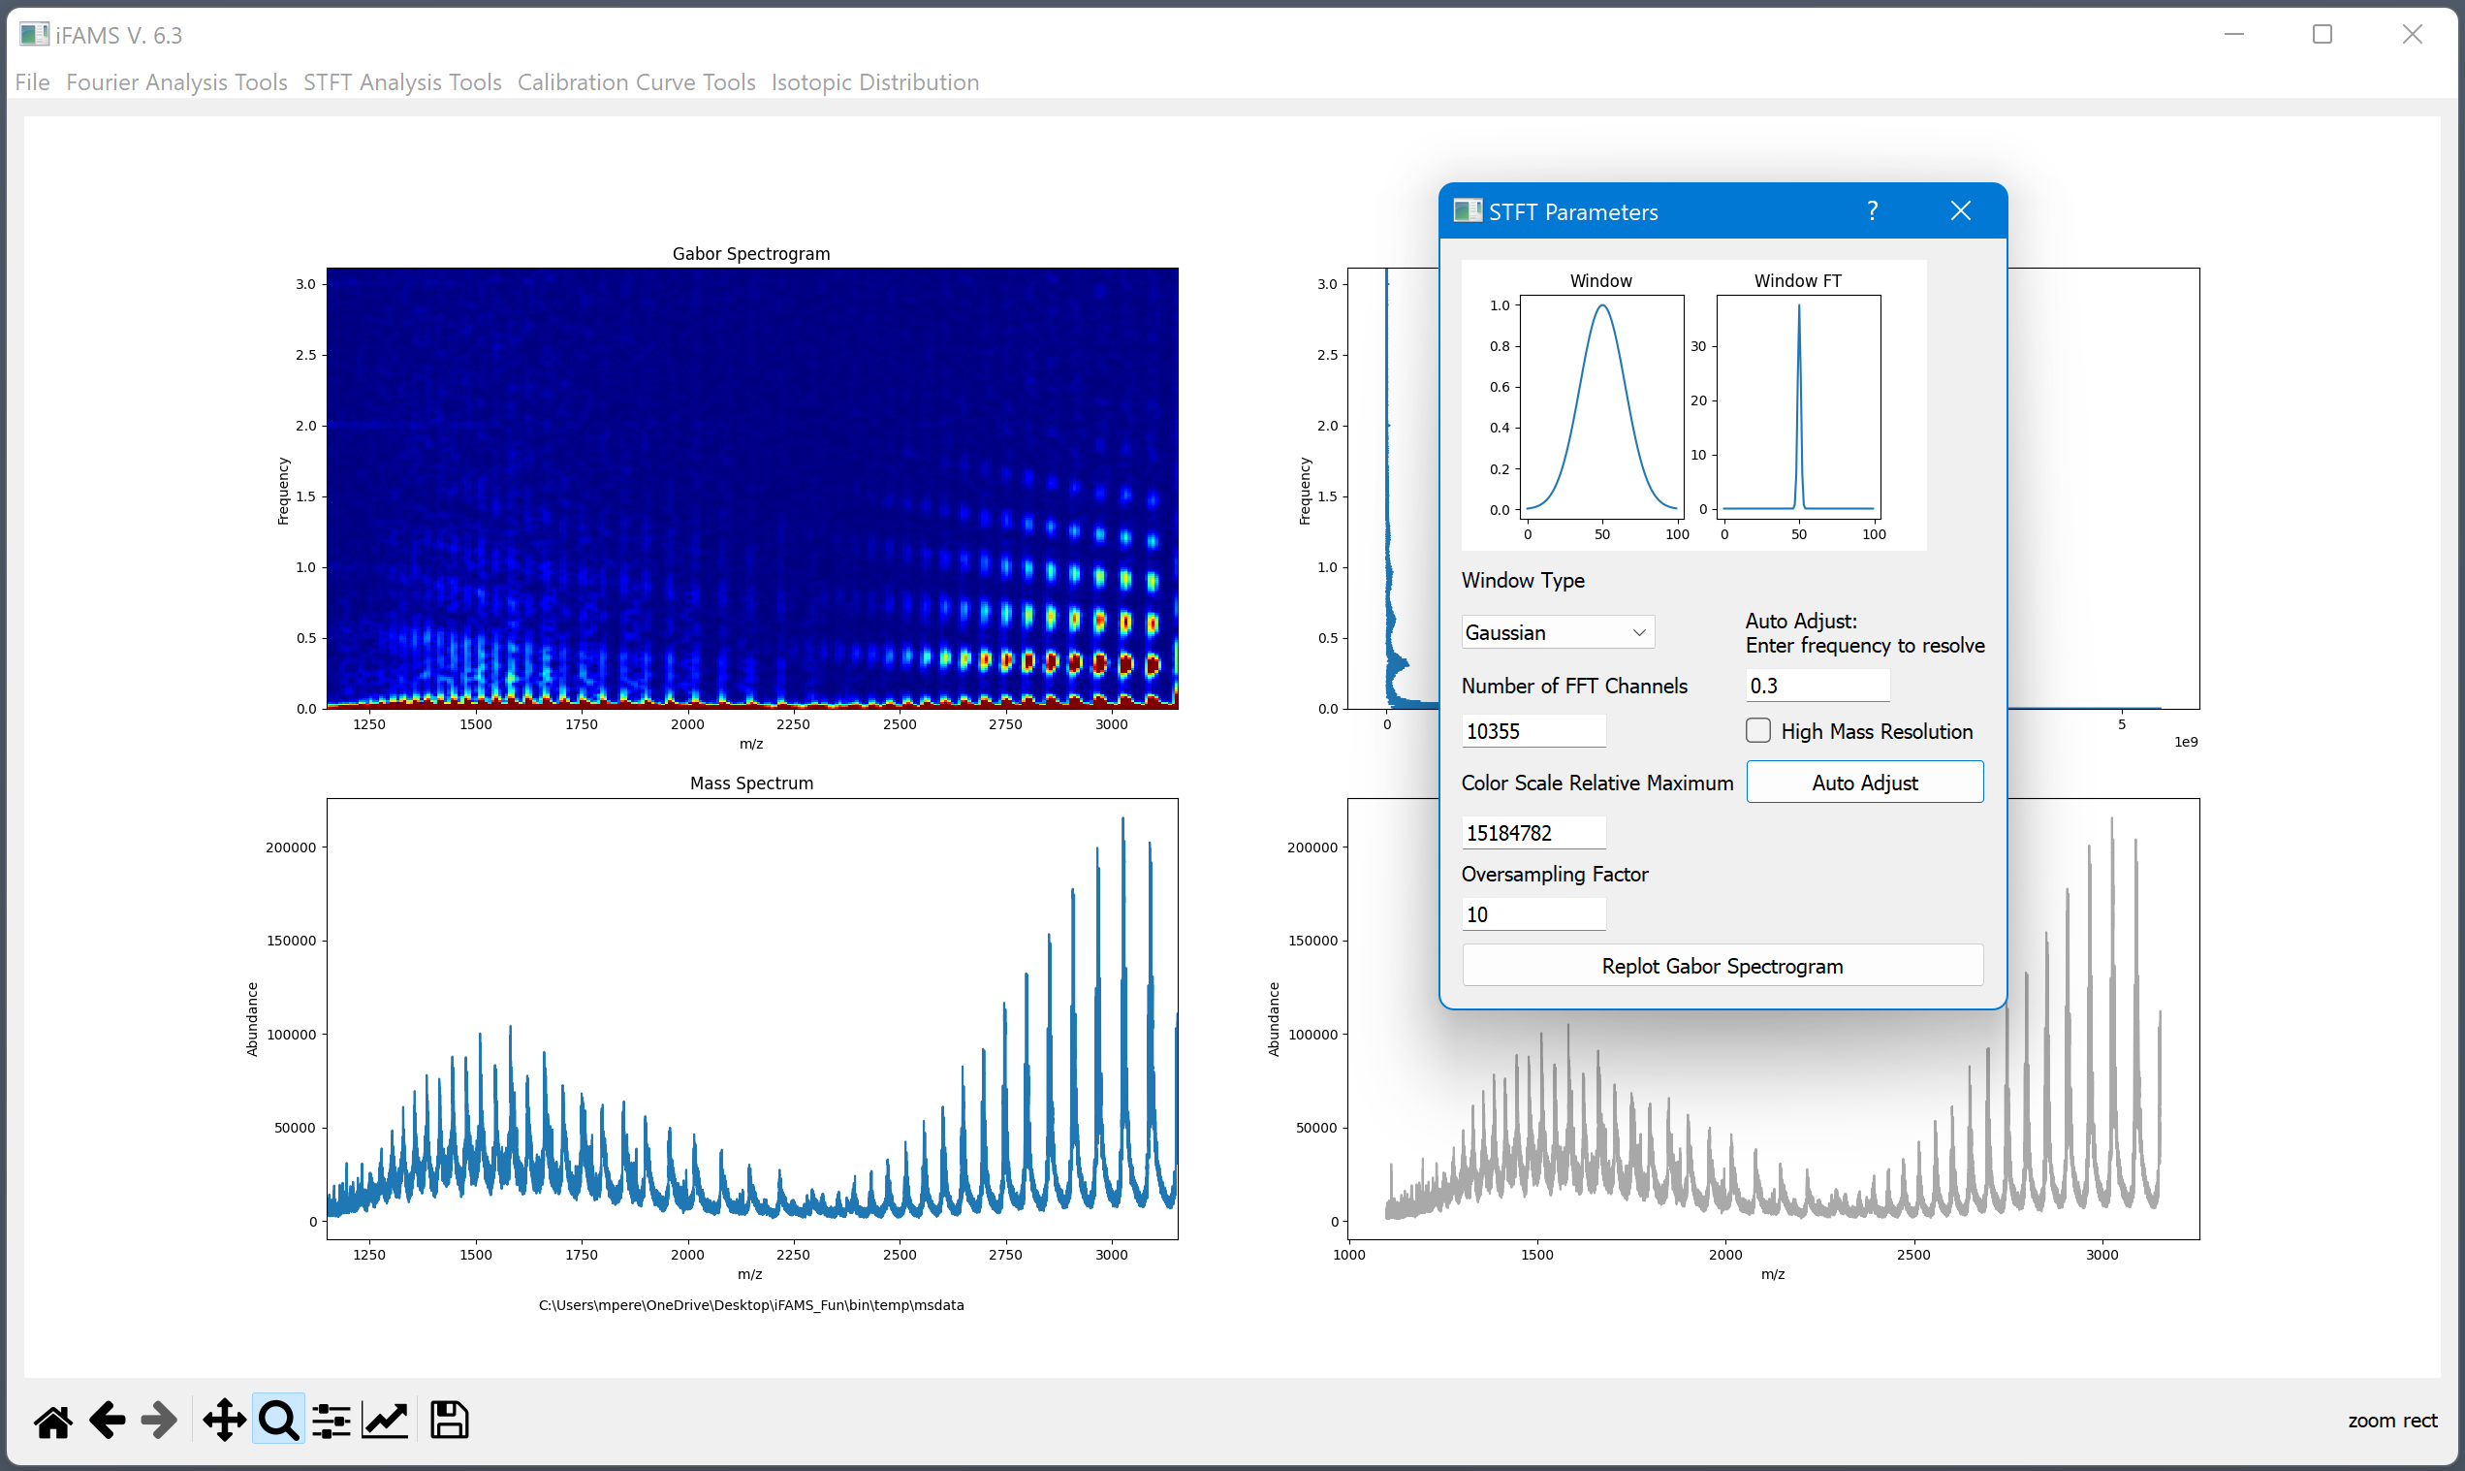

Slide 17
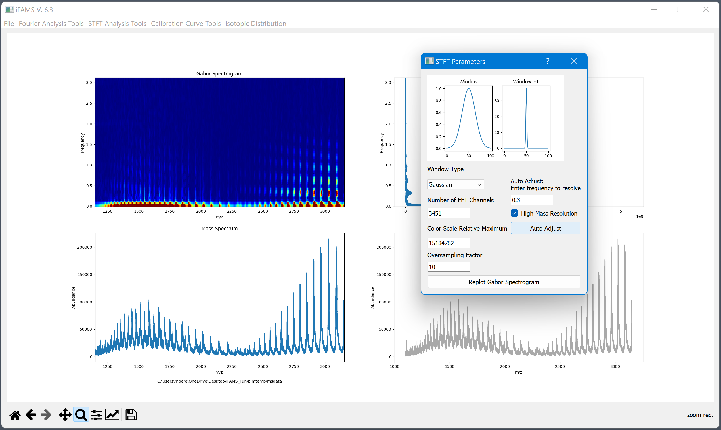
Decreases FFT channels to increase mass resolution in the spectrogram at the expense of frequency resolution

Slide 18
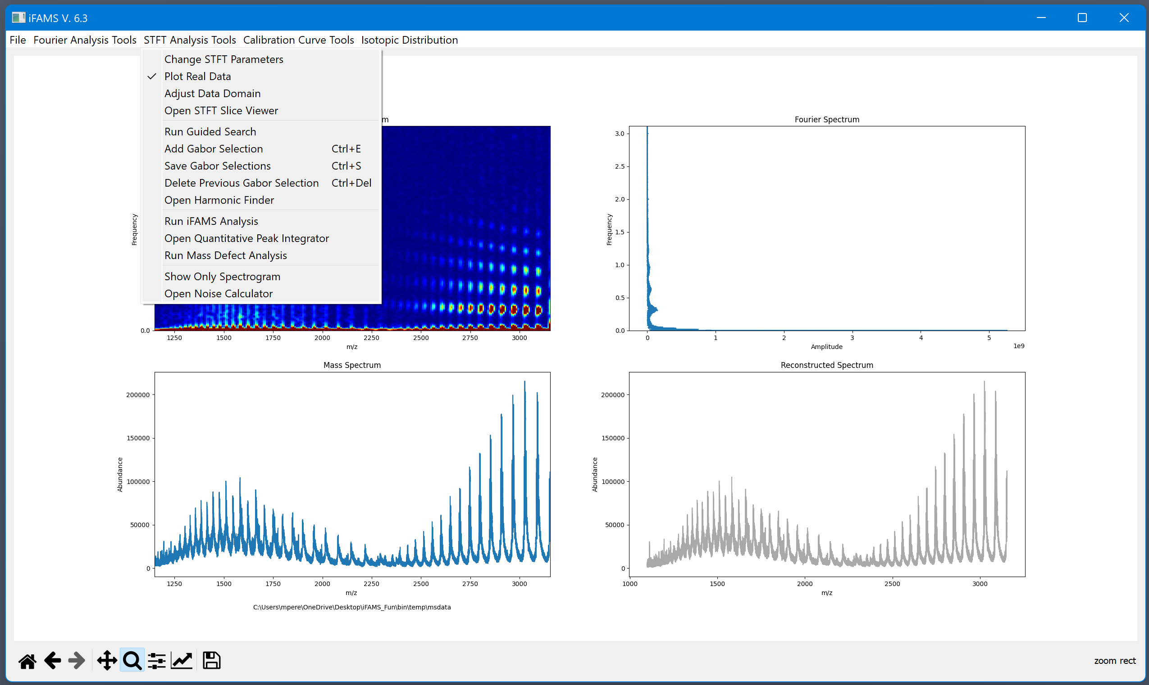
Removing high mass resolution for this example…
We are ready to select signal from the spectrogram
Once selections are started, do not readjust STFT spectrogram parameters

Slide 19
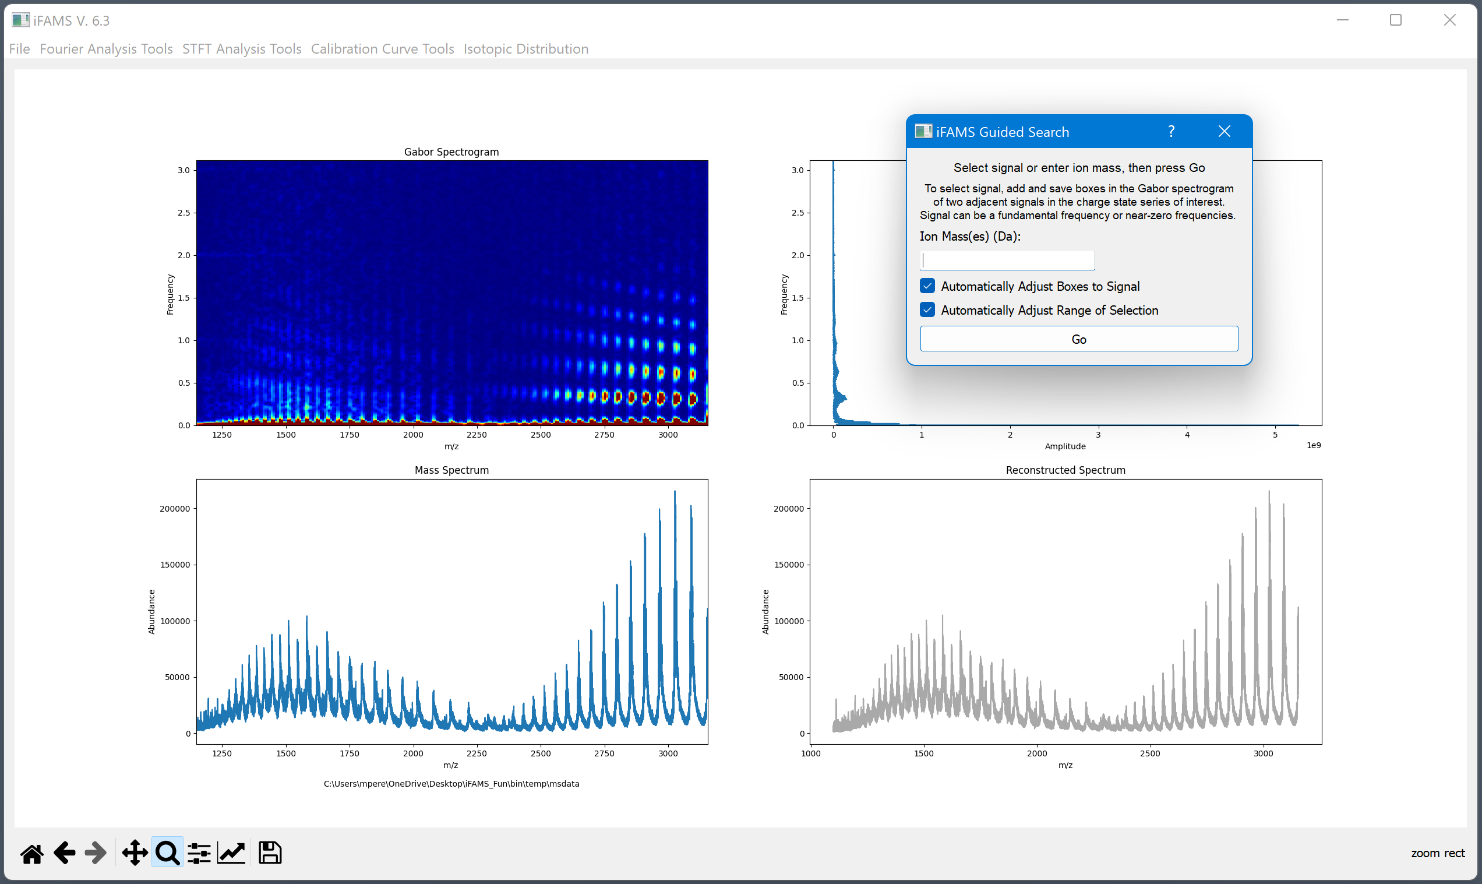
Entering ion mass works well for isotope resolved signal.
Manually selecting two adjacent signals works well for most types of signal.

Slide 20
These options are selected by default and are recommended for most cases.
For particularly challenging cases:
The top option adjusts each box when making selections. If deselected, the selections are made with average box shapes positioned about maxima.
The bottom option selects a range a charge states that pass an abundance threshold. If deselected, the range selected will include every possible charge state in the m/z range.

Slide 21
Fundamental signal for NIST mAb
Select two adjacent fundamental signals:
Draw one box on the spectrogram
“Add Gabor selection” (ctrl + e)
“Save Gabor selection” (ctrl + s)
Repeat 1-3 for adjacent signal

Slide 22
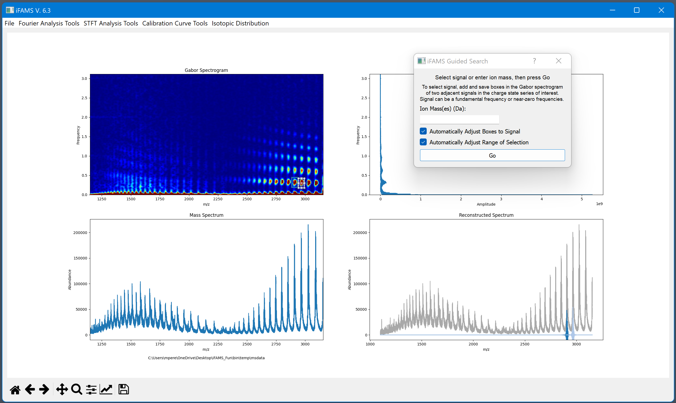
Press “Go” once two adjacent signals have been selected
Inverse FT spectra populate here as selections are made

Slide 23
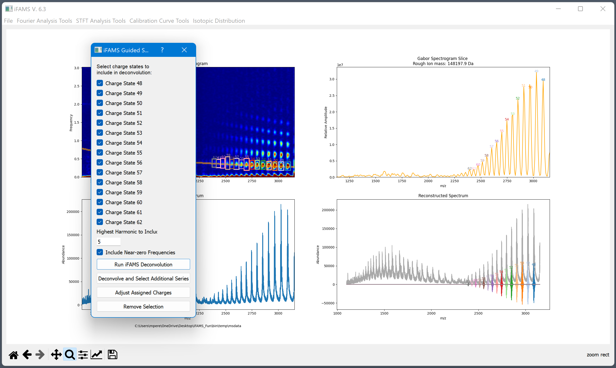
Spectrogram slice (shown in orange) helps with verifying charge state selections

Slide 24
Individual charge states can be selected from deconvolution
Suggested number of harmonics is editable (1st harmonic = fundamental)
Allows multiple proteins to be processed one at a time

Slide 25
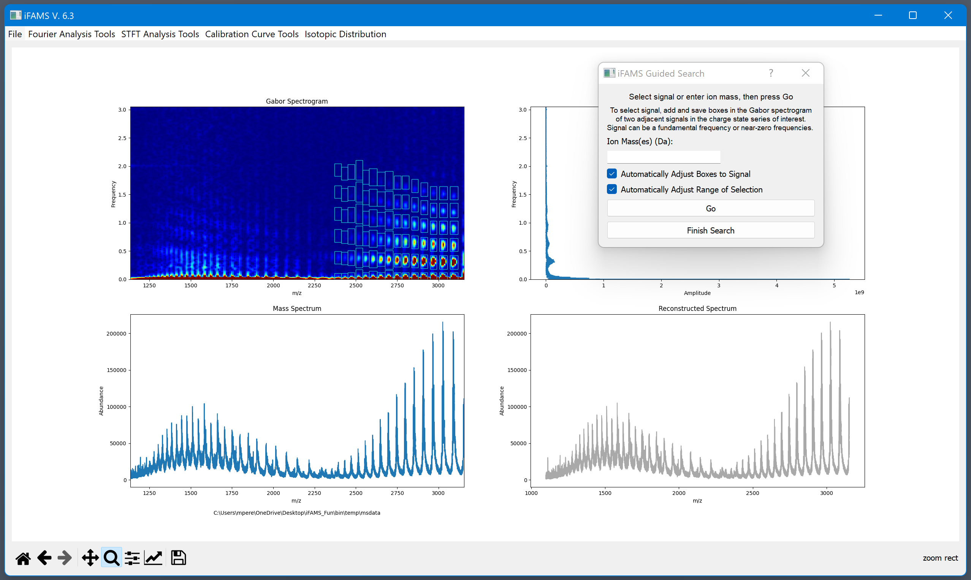
Stored selections displayed here

Slide 26
No strong or isolated fundamental frequency

Slide 27
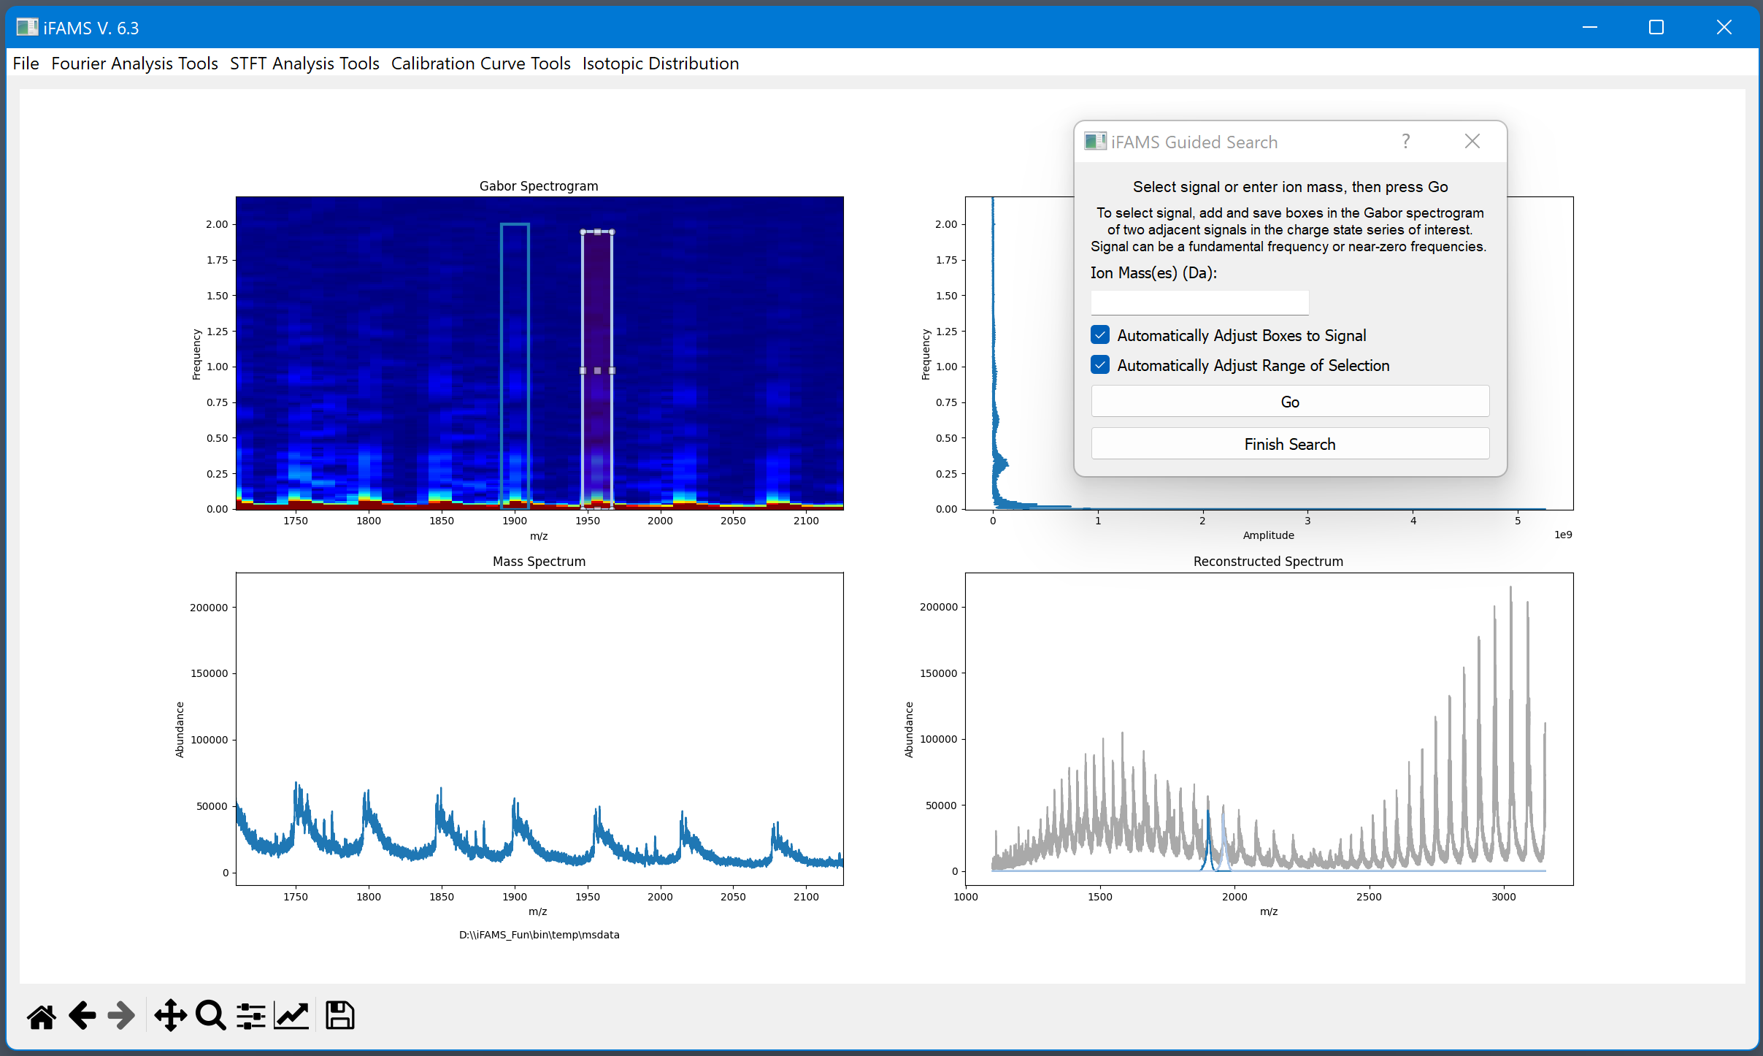
Zoomed in…
Selecting the near-zero frequency (including the zero frequency)

Slide 28
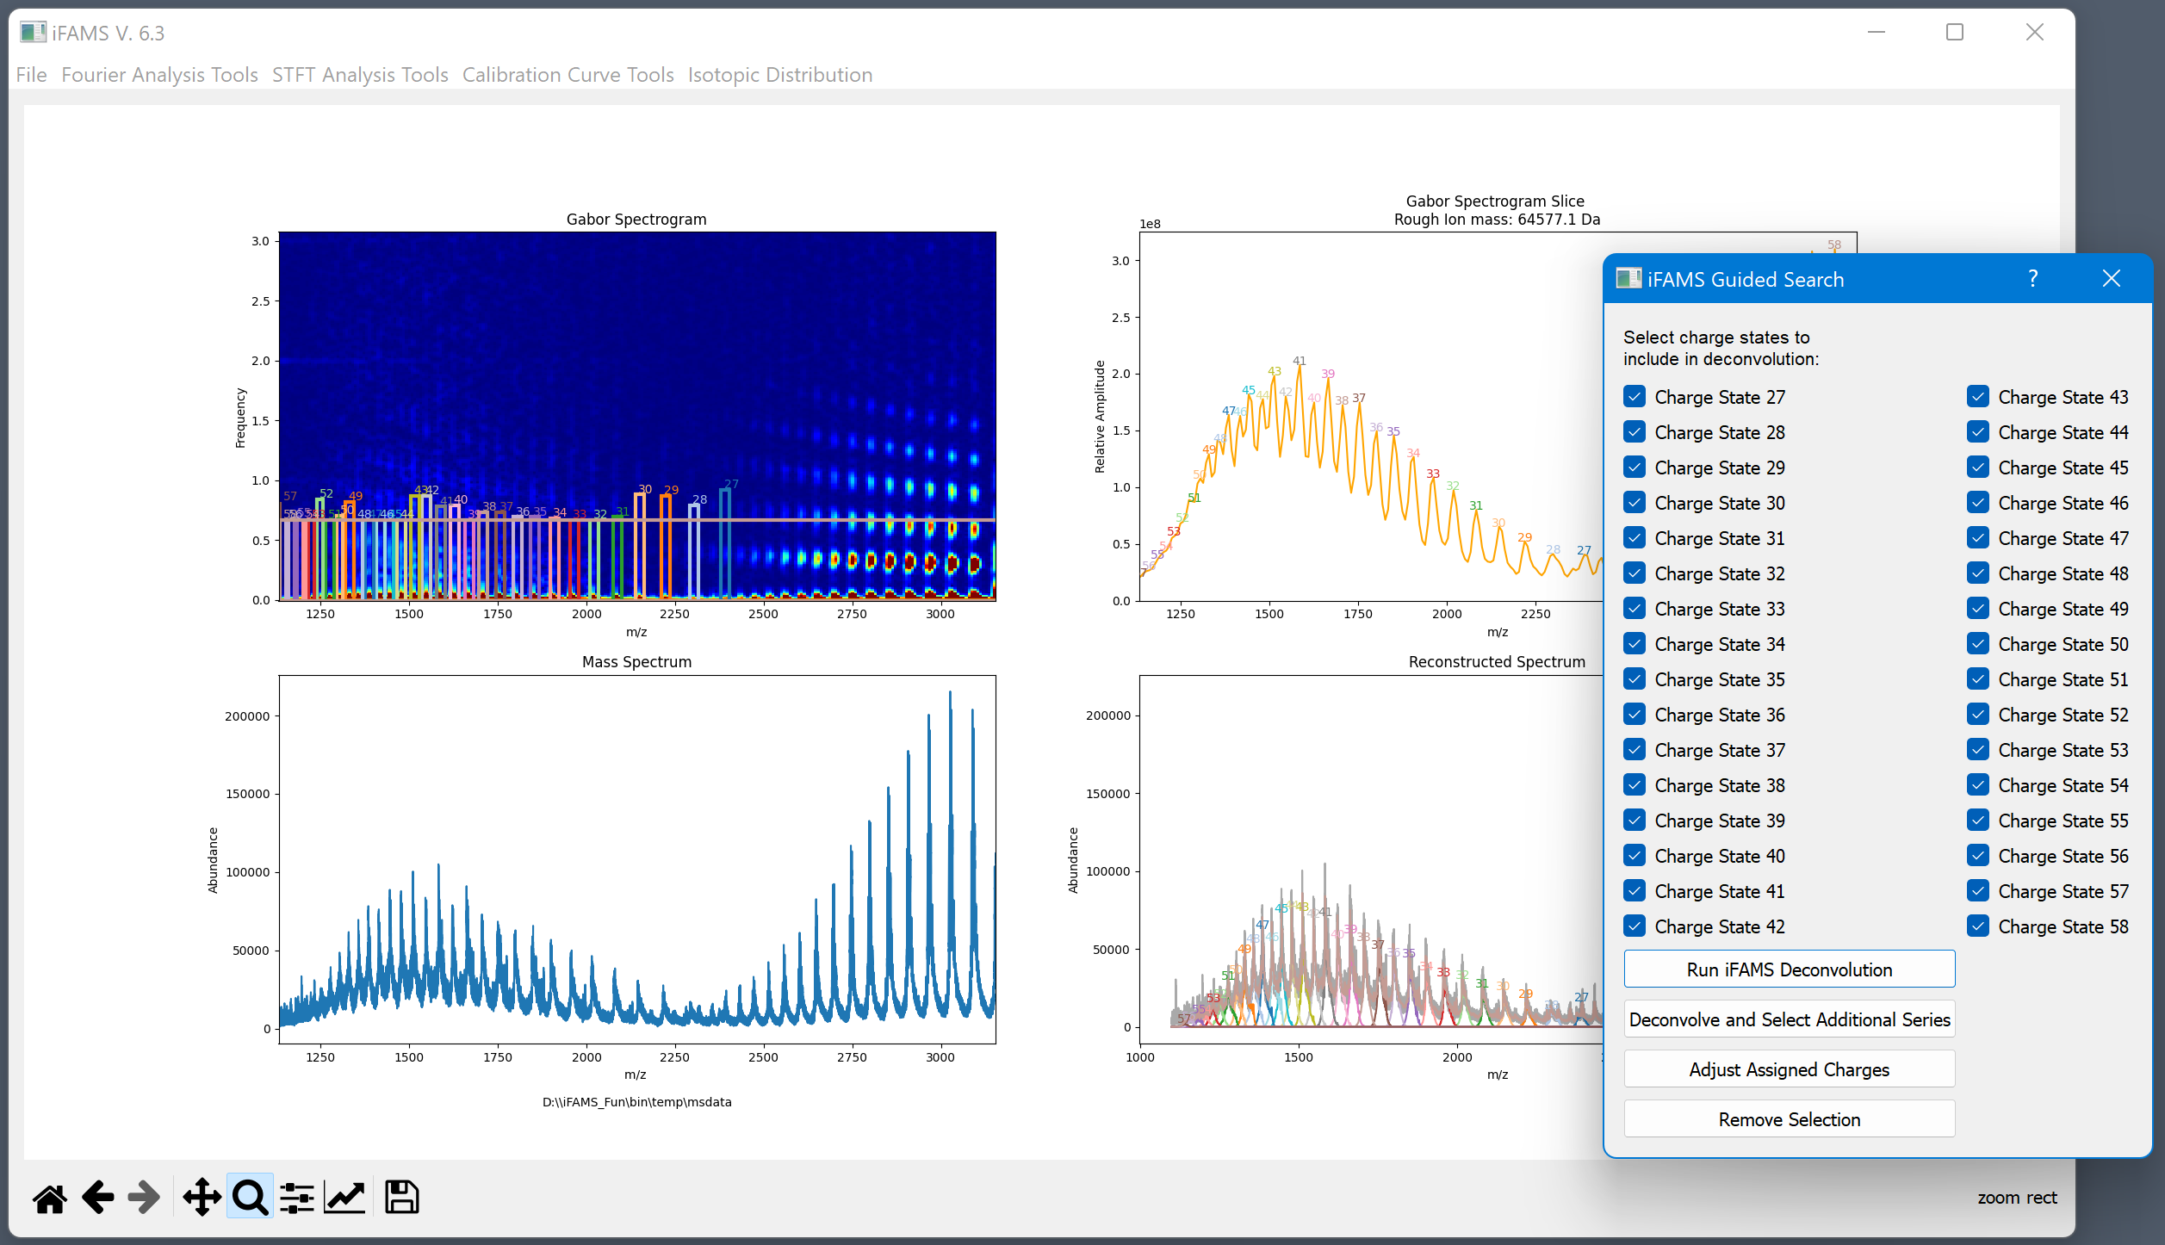
Unsatisfactory results…
Selections can be removed to try the search again with different initial parameters, or the selections can be tweaked

Slide 29
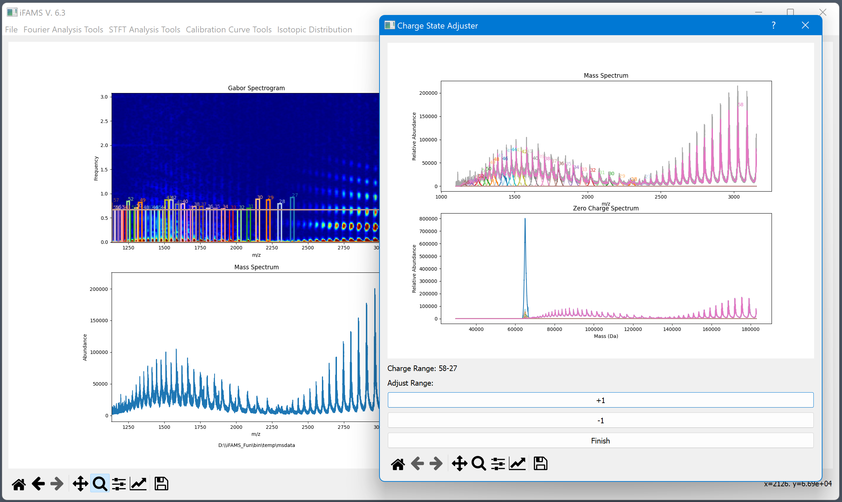
Charge-corrected inverse FT spectra
Combined zero-charge spectrum

Slide 30
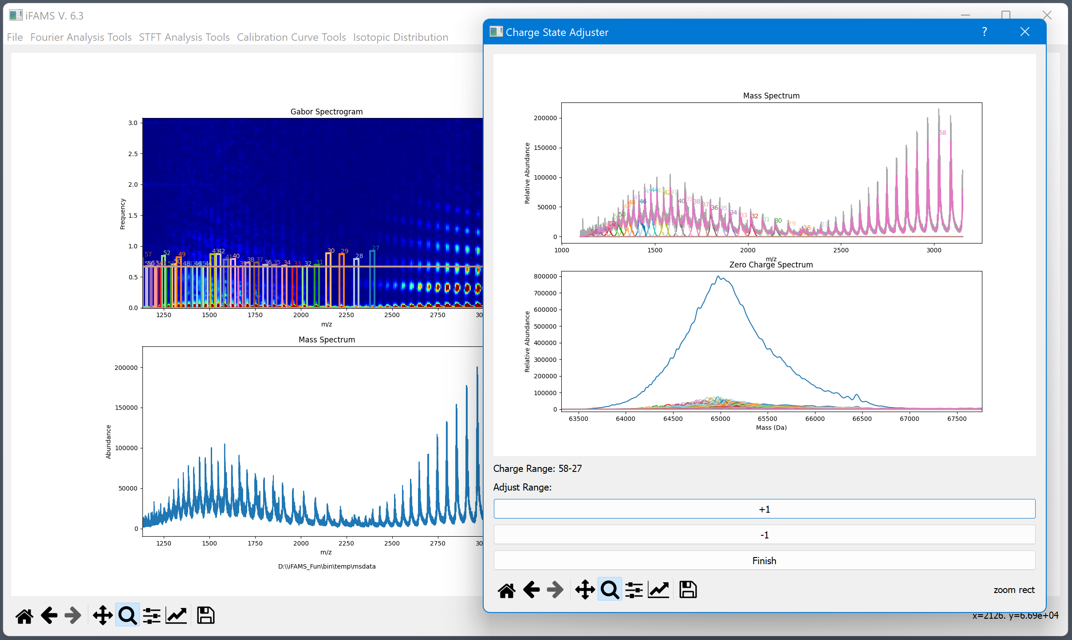
Original charge range zoomed in

Slide 31

Original charge range -1
x2

Slide 32

Charge states were originally estimated too low by one
Original charge range +1

Slide 33
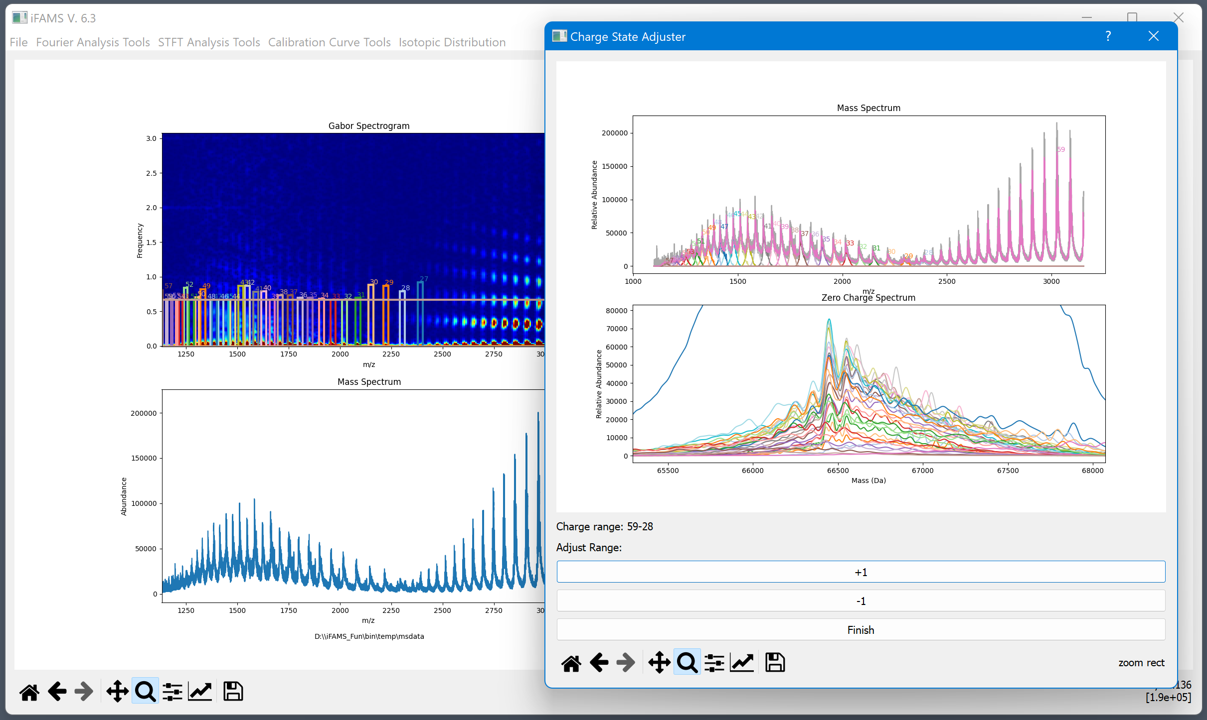

Slide 34

The charge states are now adjusted

Slide 35
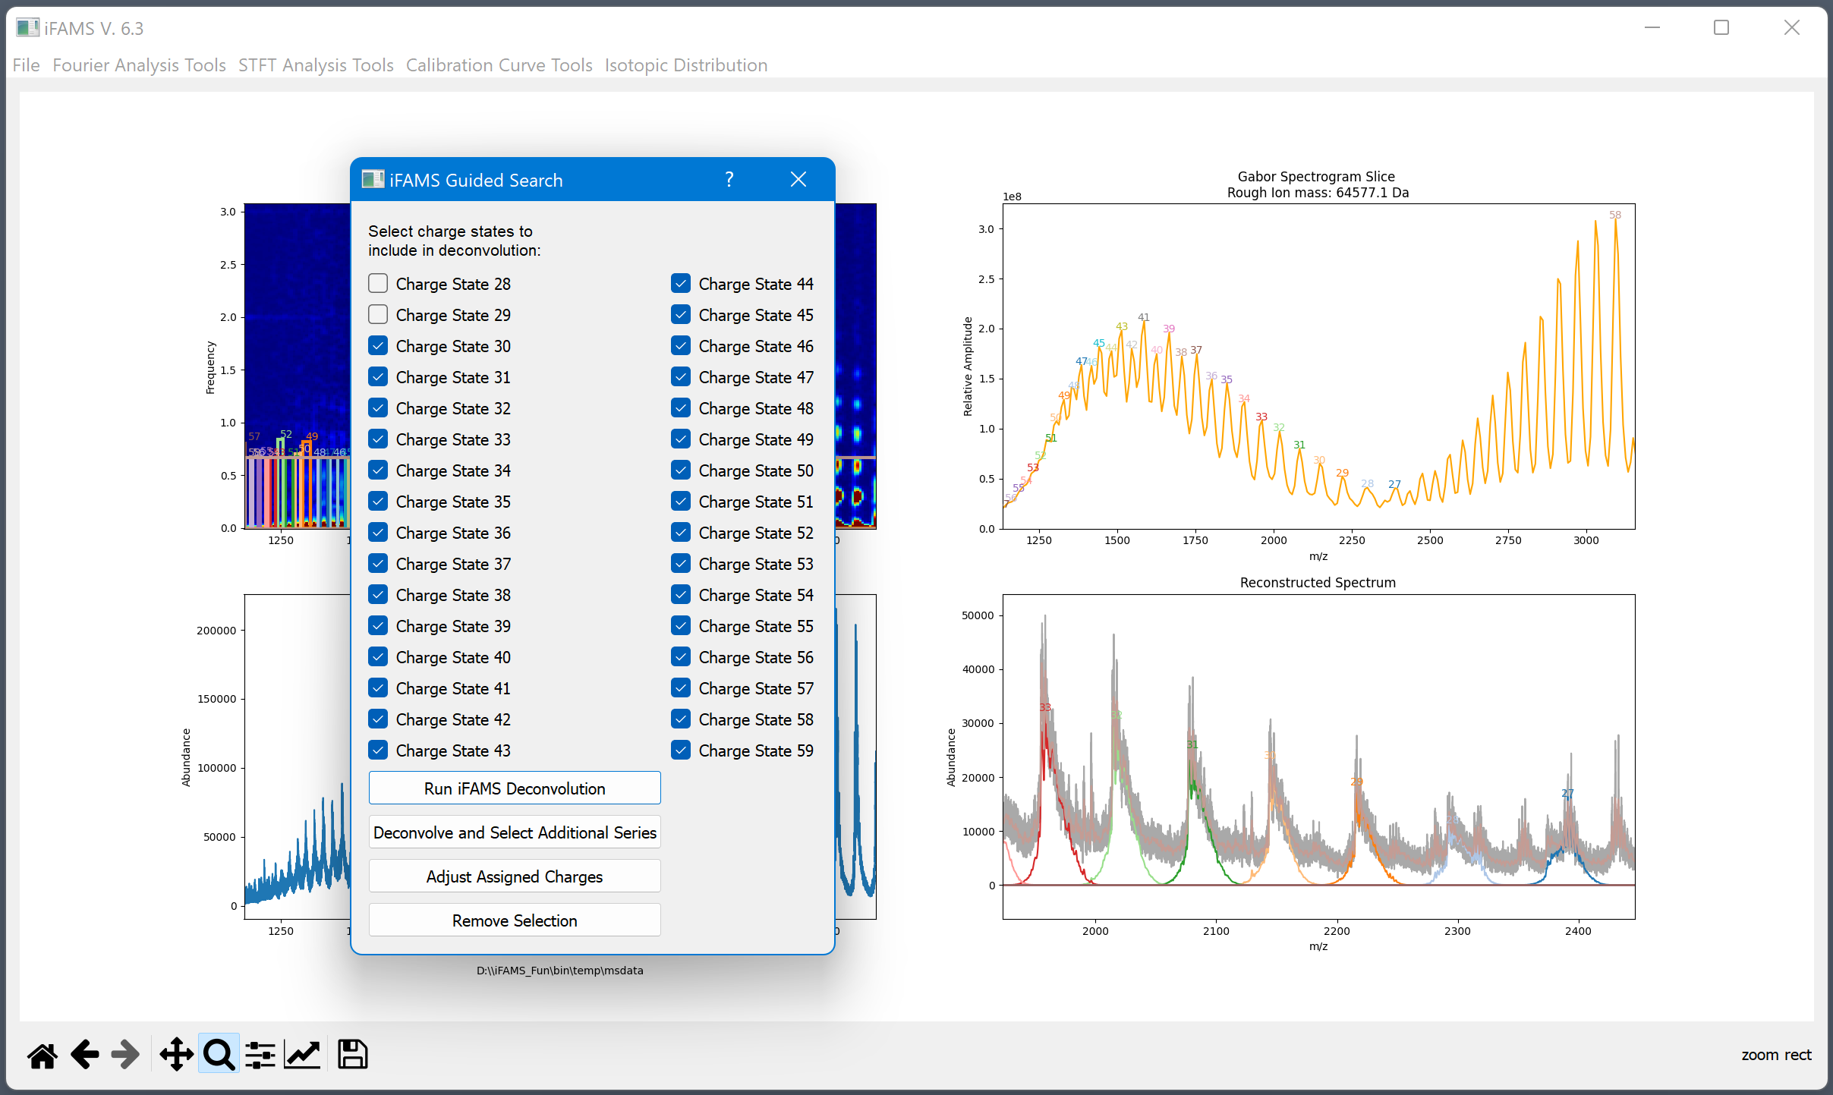
Investigating the high m/z end of the distribution
Cut off about here

Slide 36
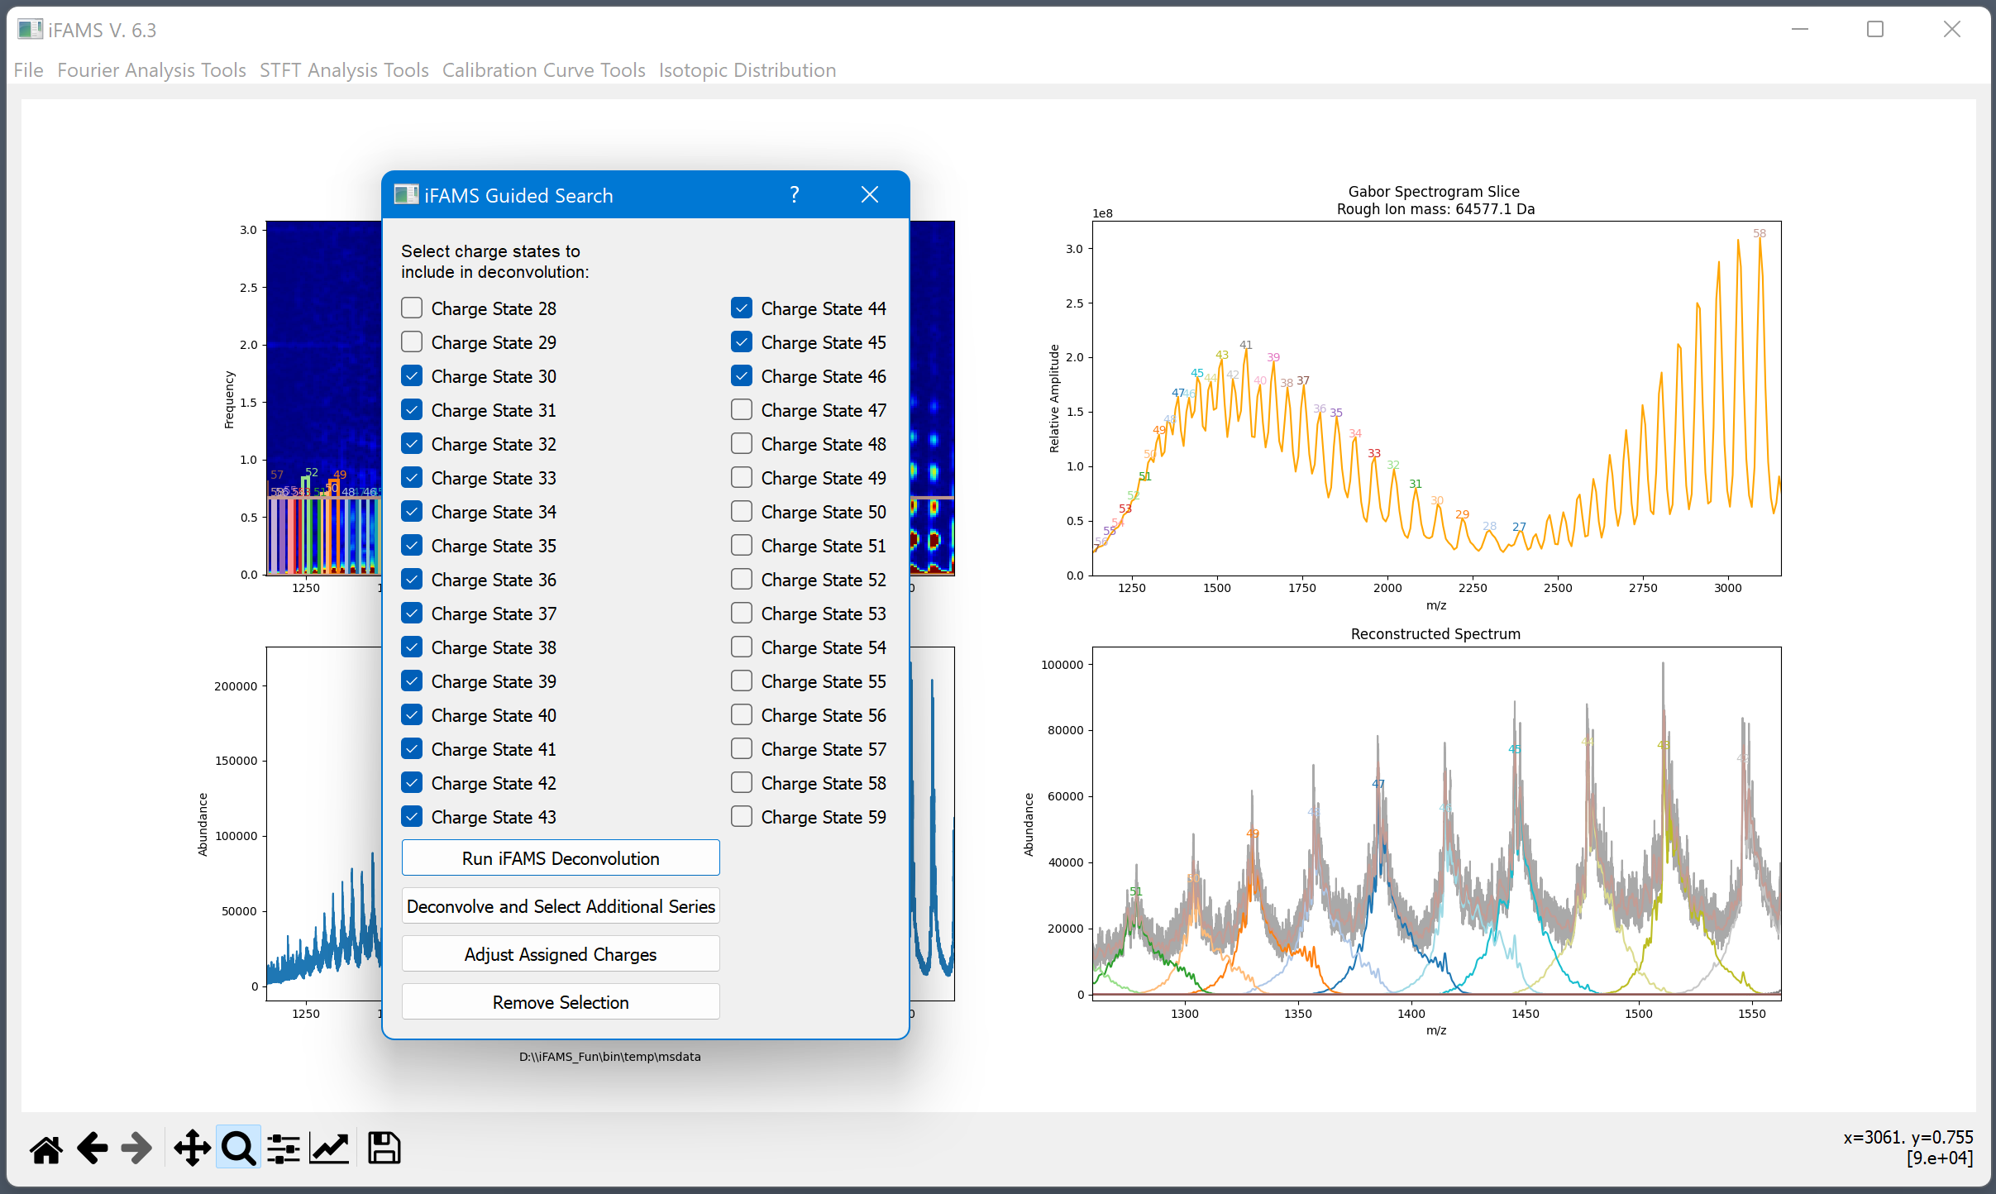
Investigating the low m/z end of the distribution
Cut off about here

Slide 37
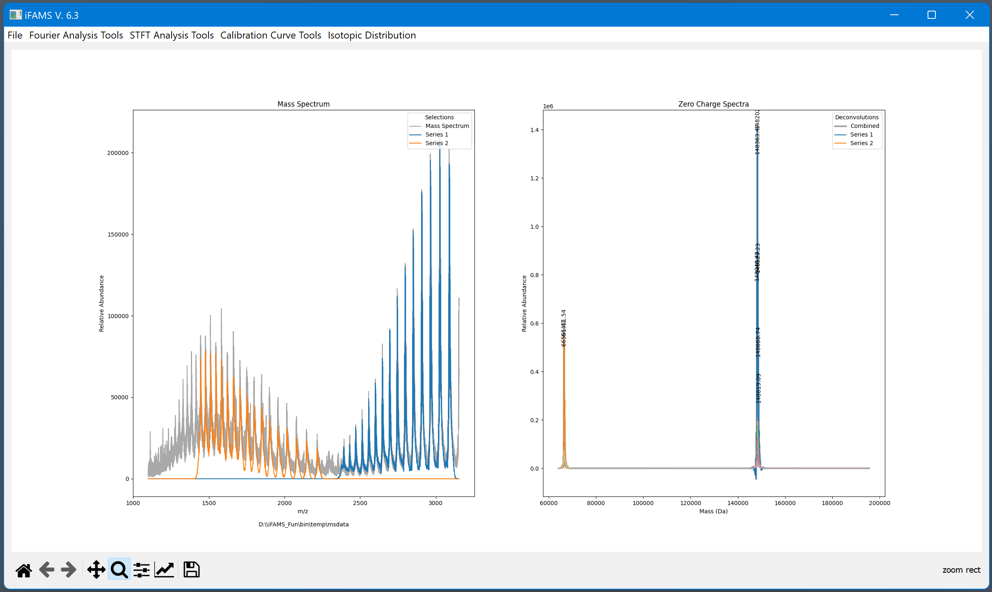
The iFAMS deconvolution corrects each inverse FT spectra by the charge and sums them together for the zero-charge spectrum.
A baseline correction is applied to each combined zero-charge spectrum to account for artifacts that arise from the Gabor selection.

Slide 38
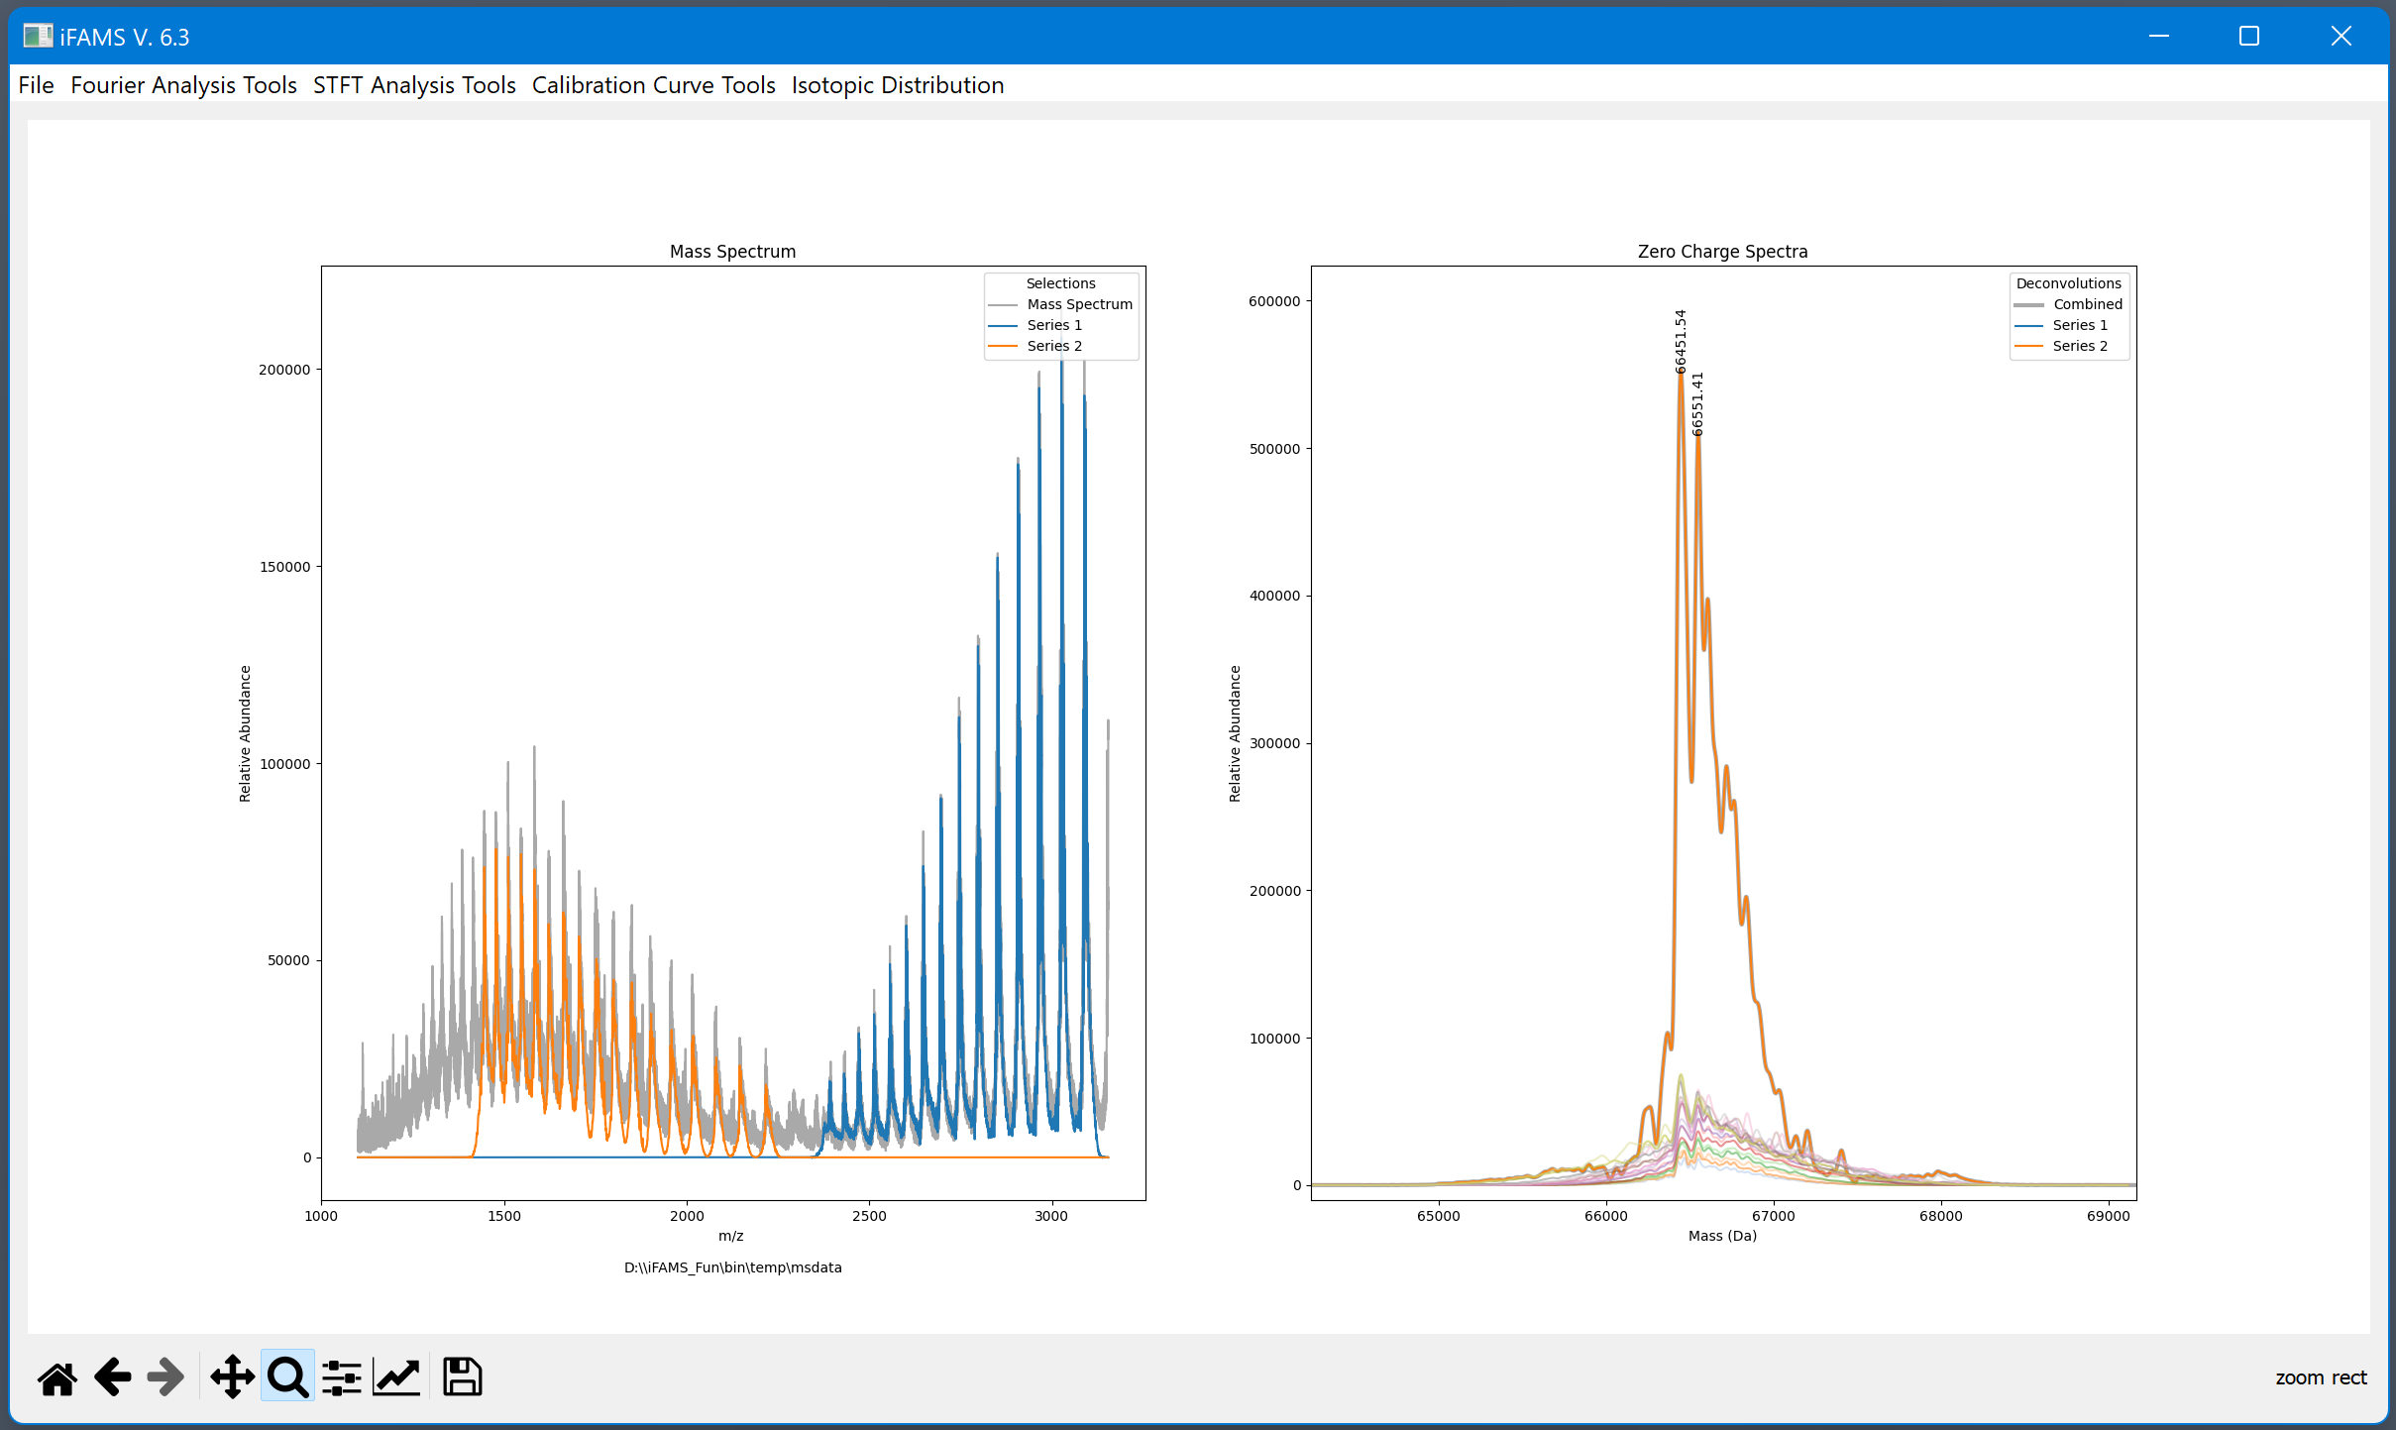

Slide 39
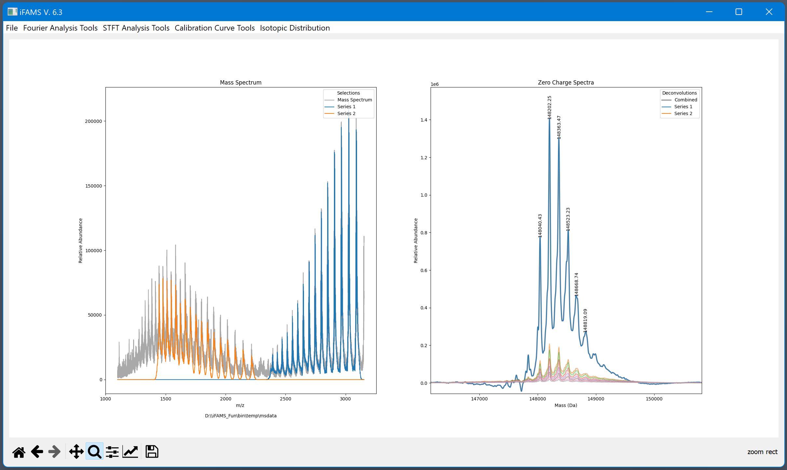

Slide 40
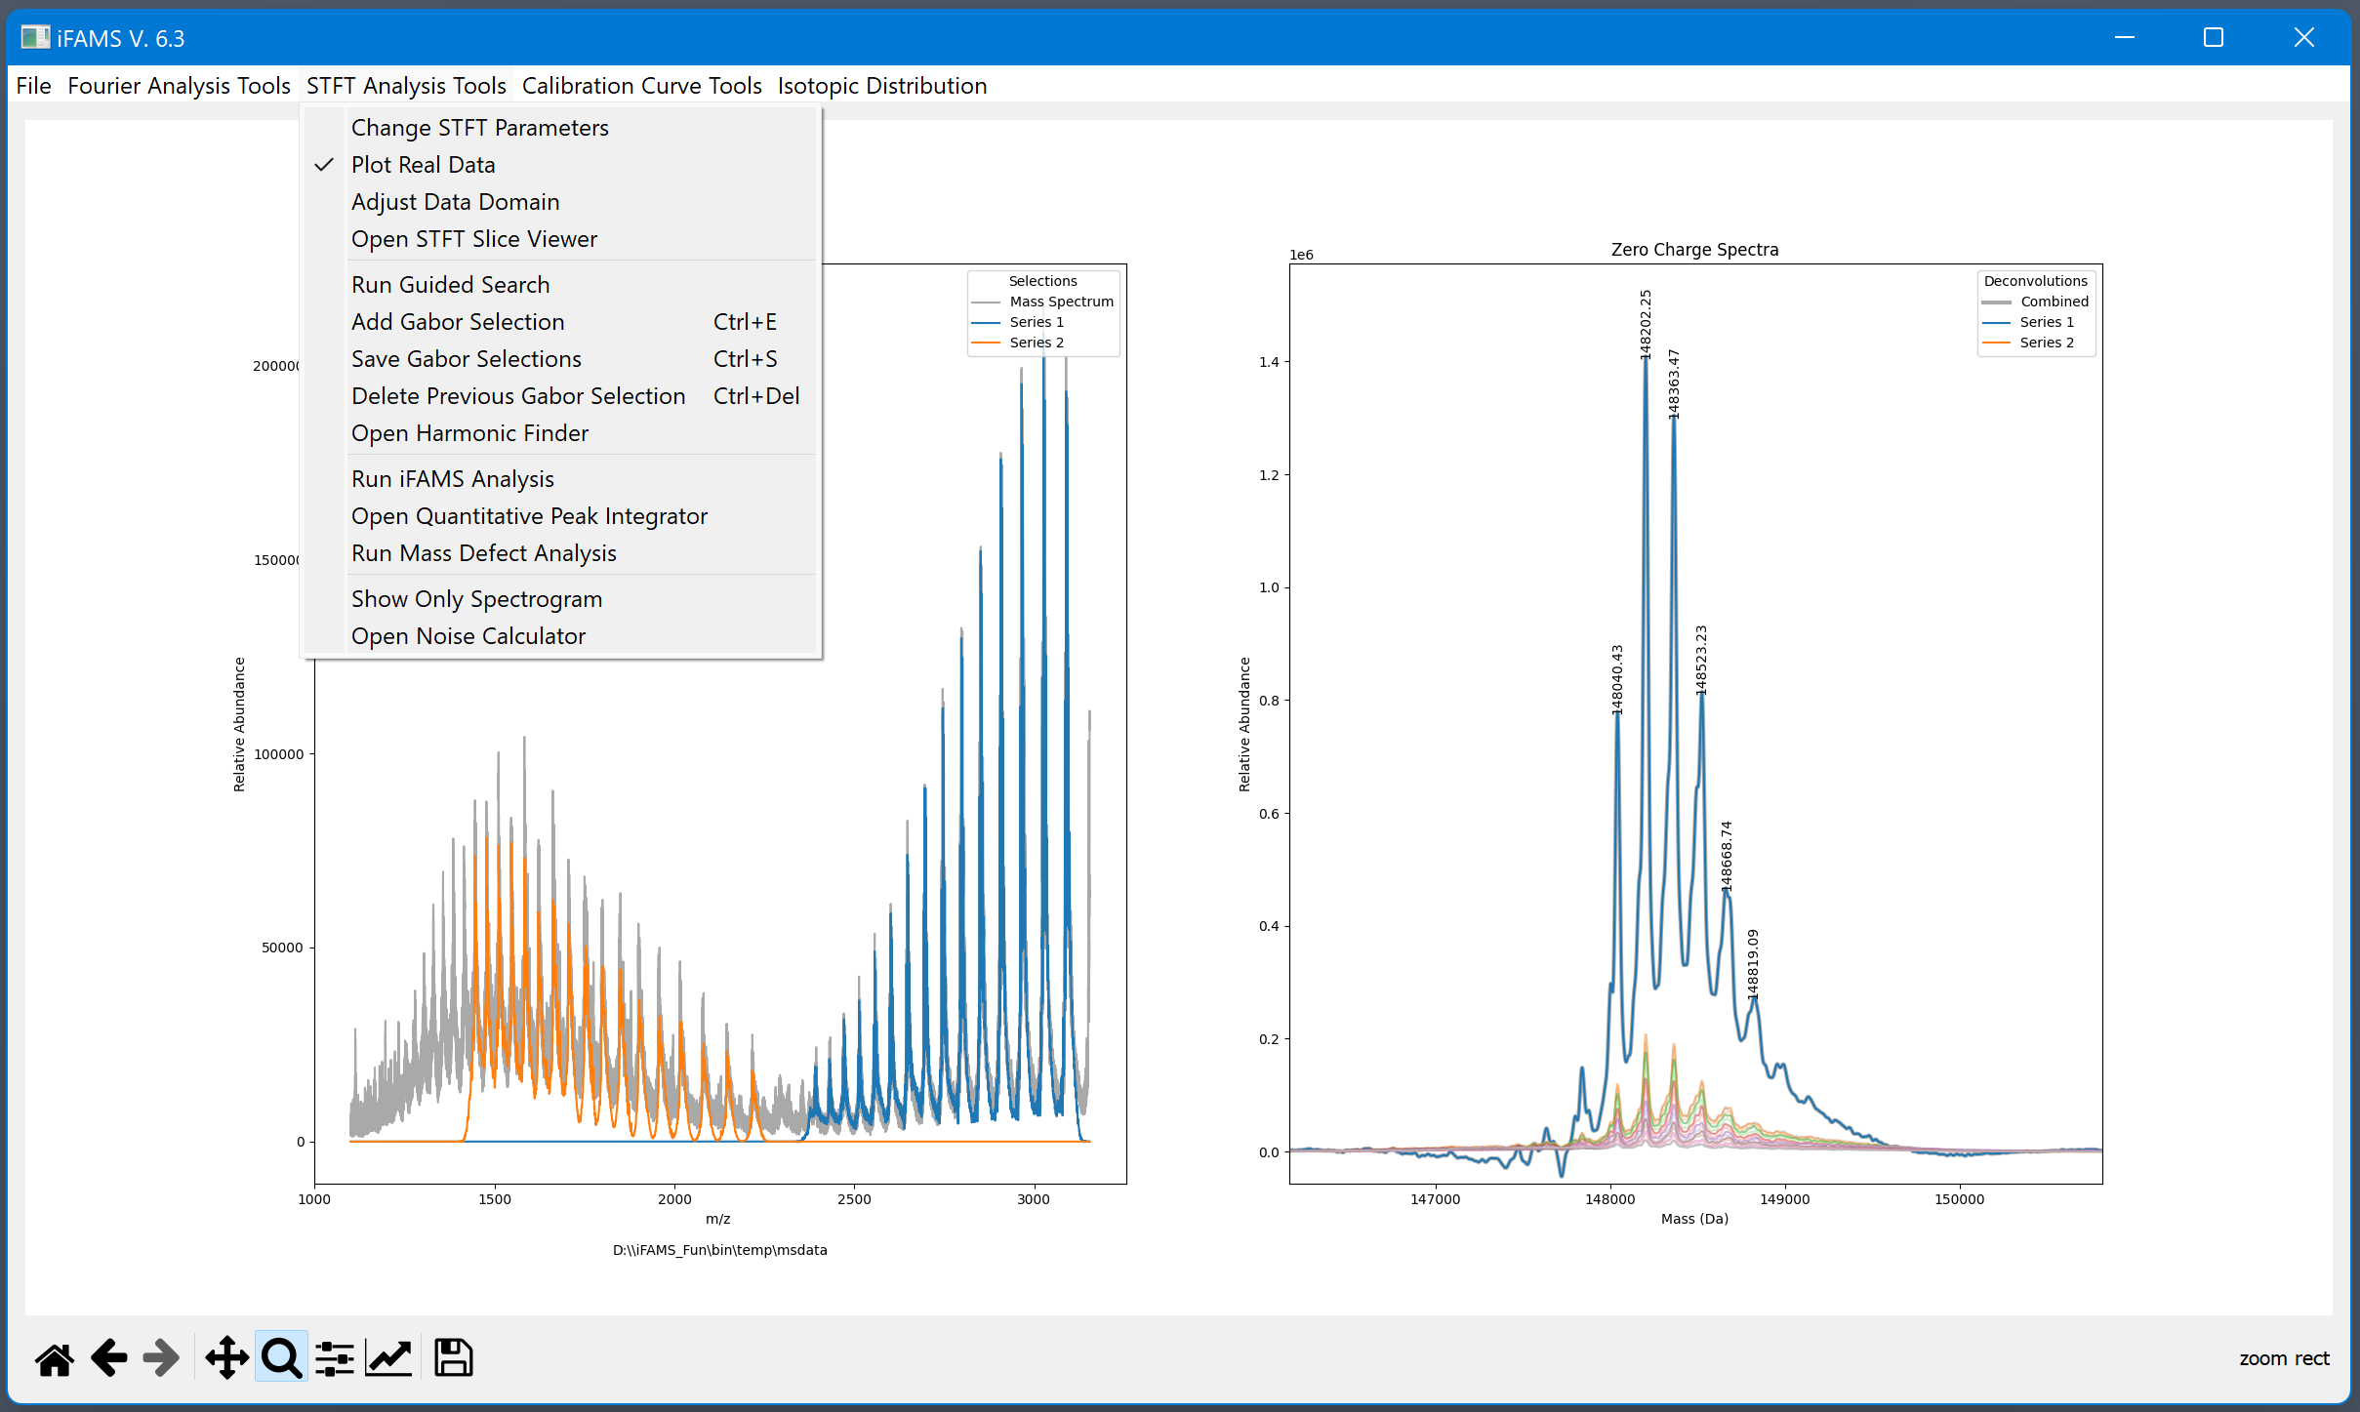

Slide 41
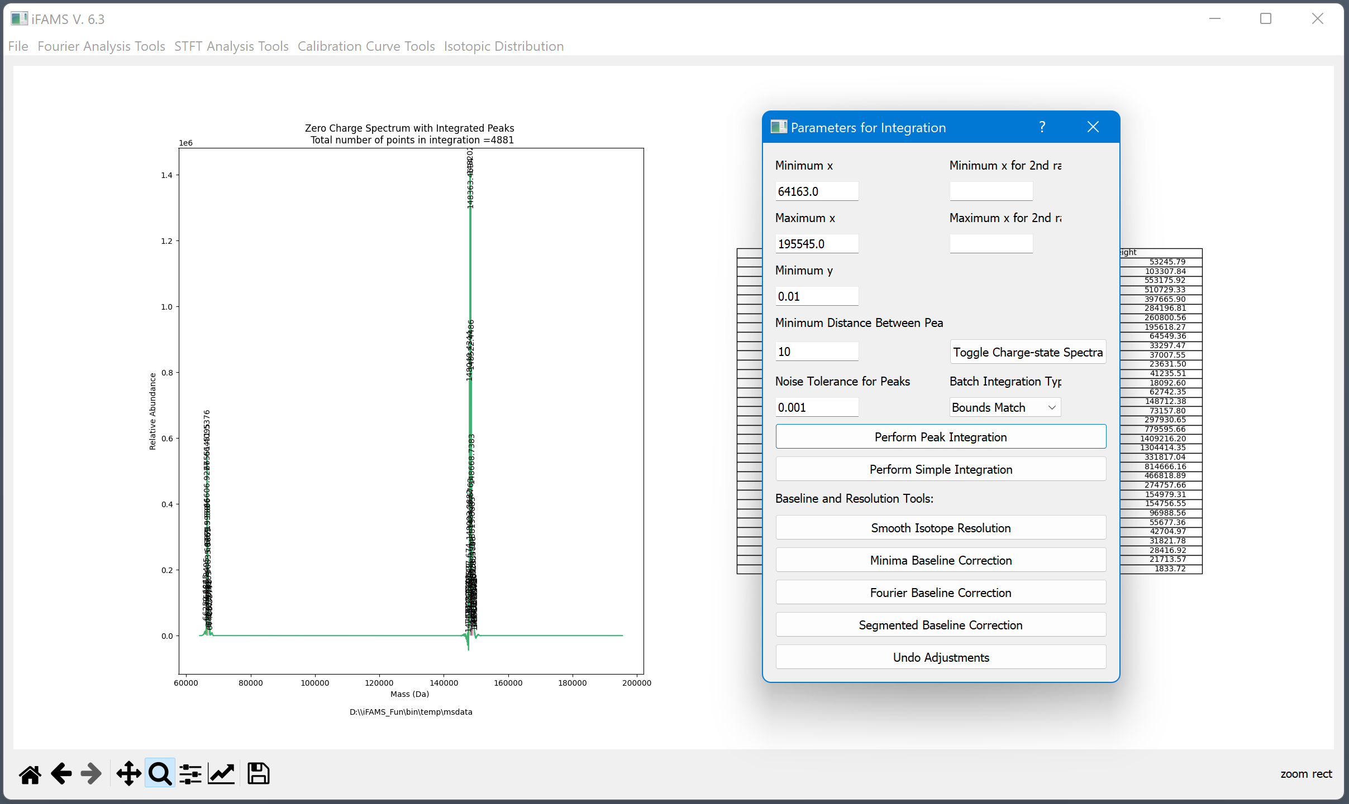
Parameters for finding peaks to integrate autofill with default or auto-calculated values.
Charge-corrected inverse FT spectra can be viewed to help interrogate validity of peaks.
Additional baseline correction options

Slide 42
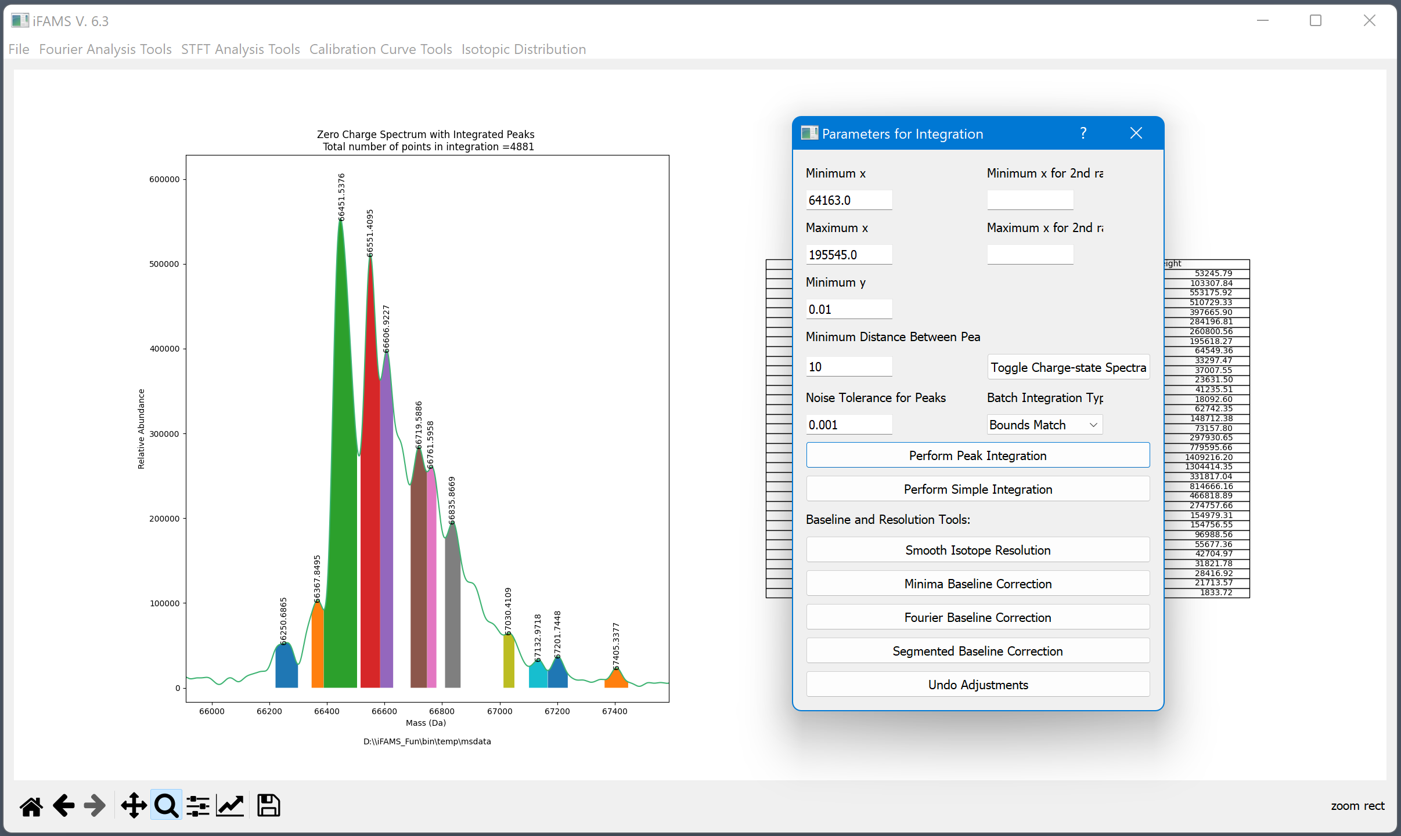

Slide 43
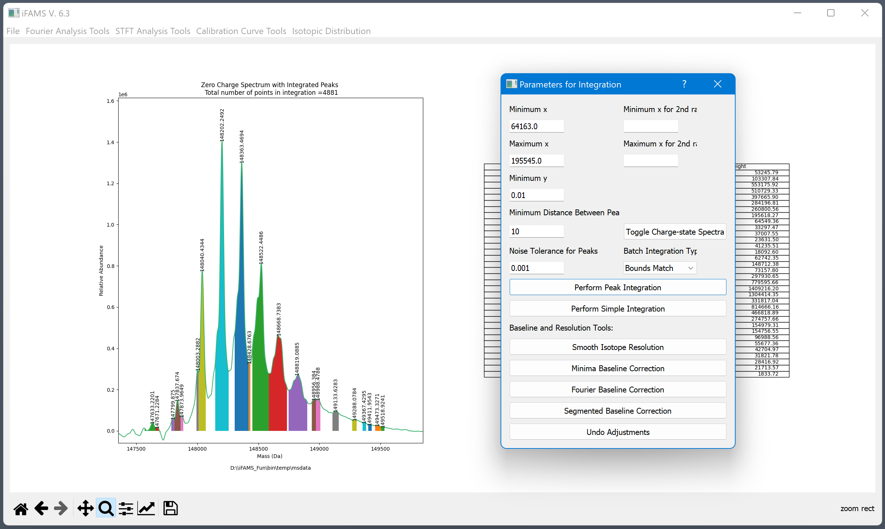

Slide 44
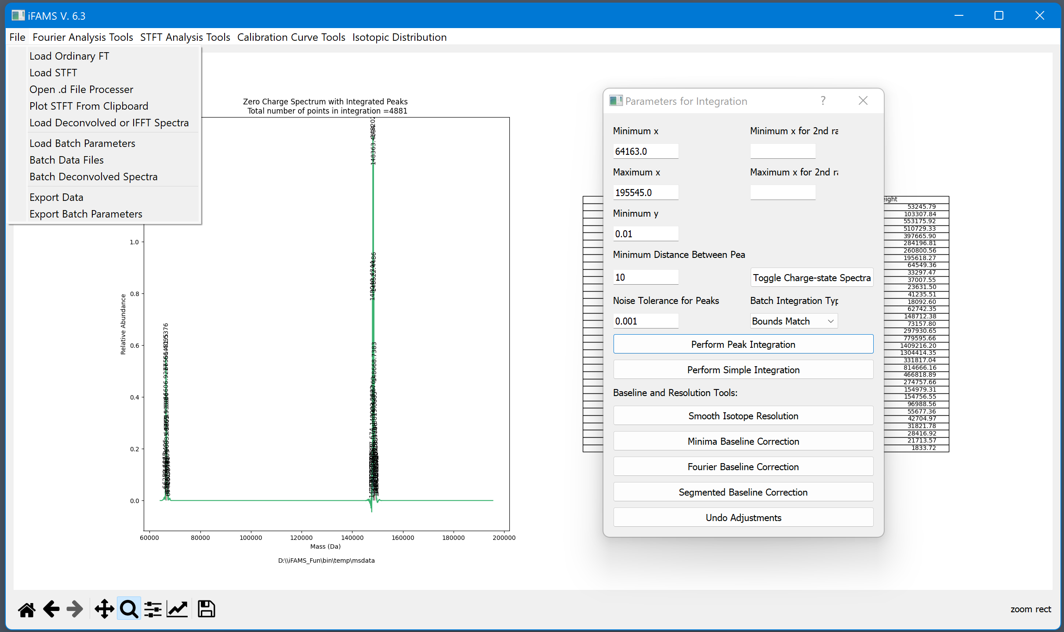
Select files (.csv, .txt, or .d) to be processed with the same parameters. This option will also save the parameters and the data from this current deconvolution.

Slide 45
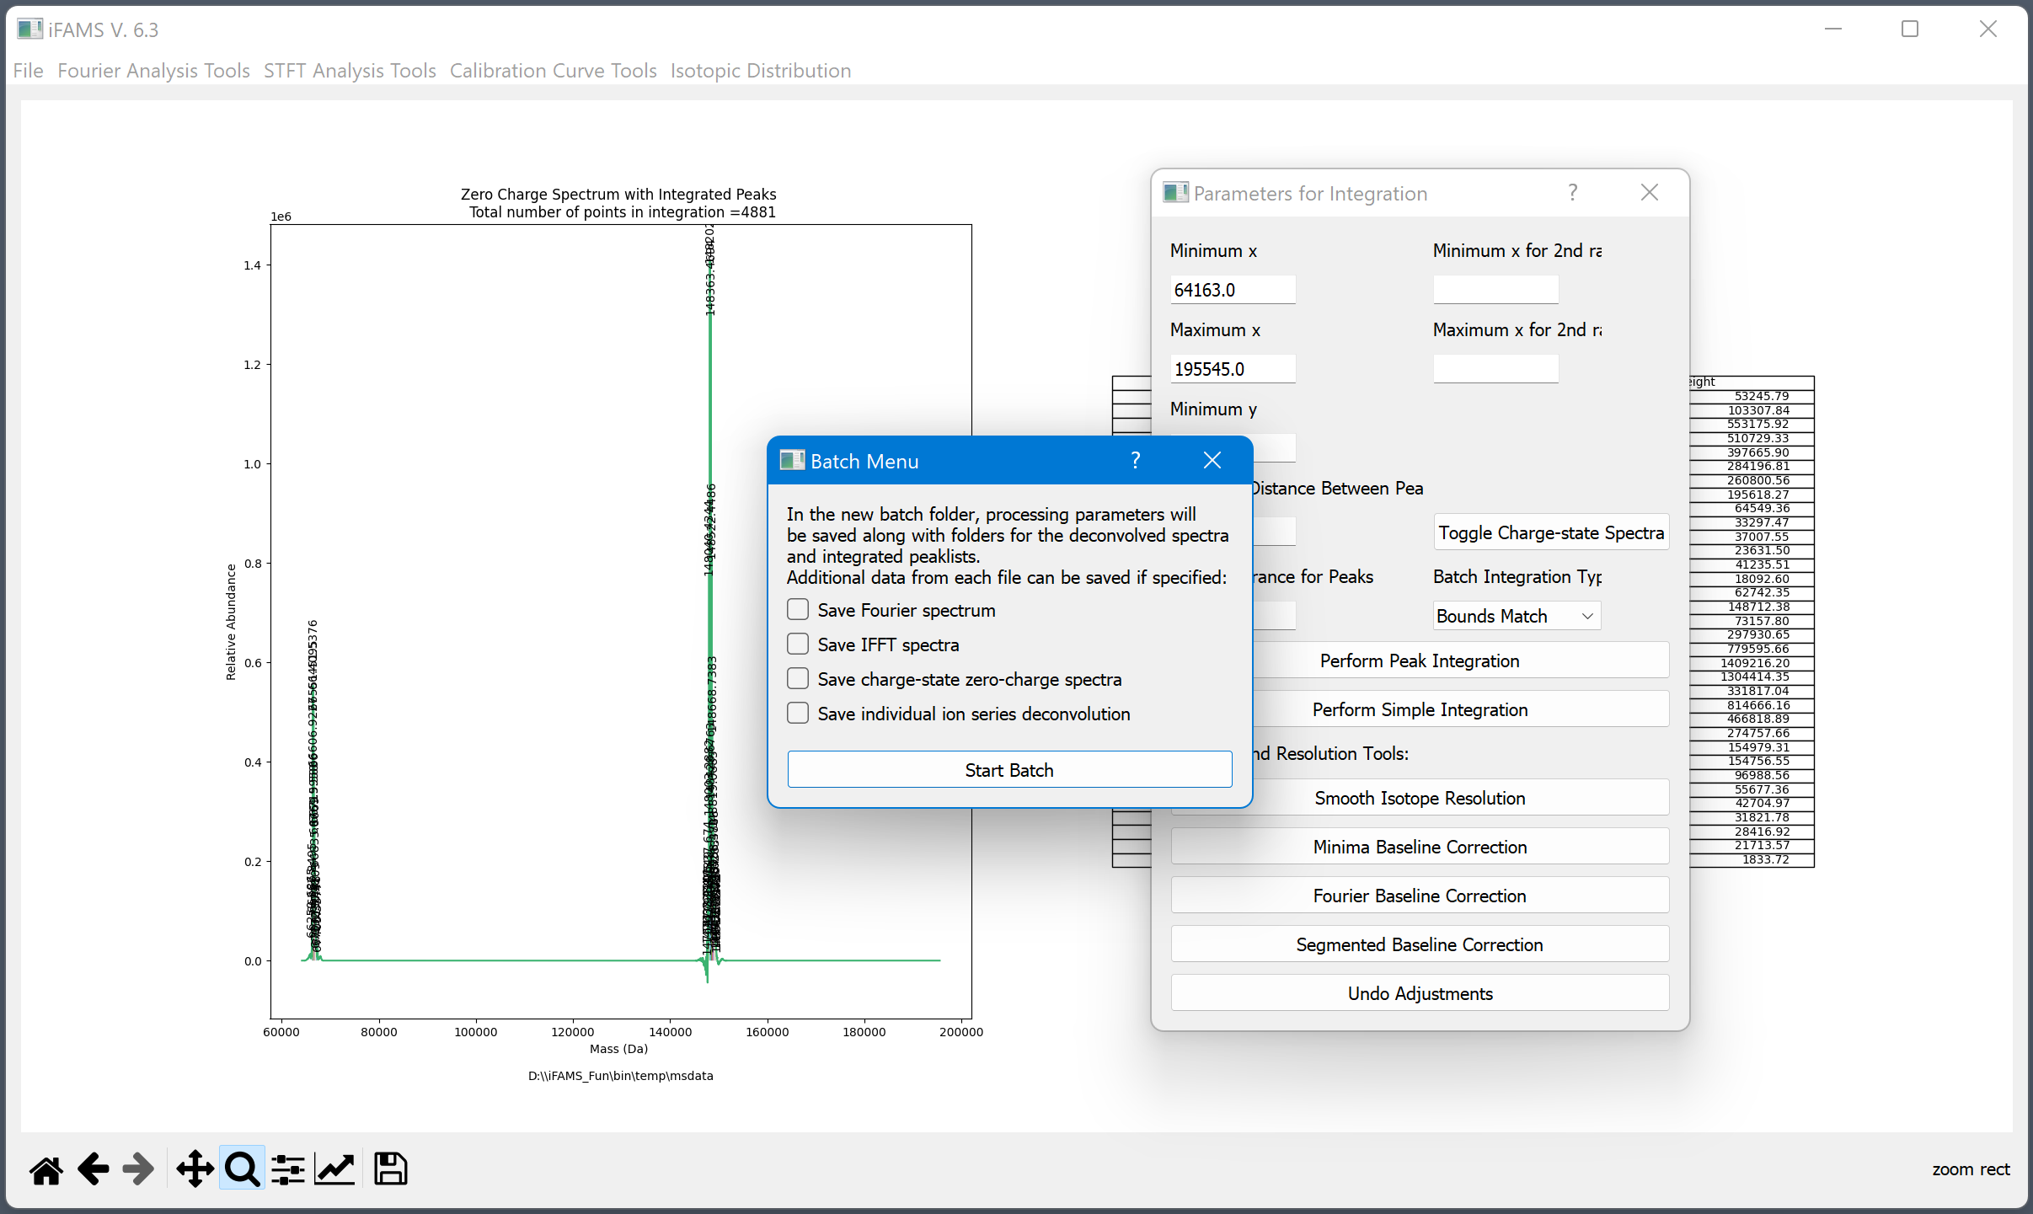
Additional data that can be saved from each file processed.
Selecting one of these options will create a new folder within the batch folder.

Slide 46
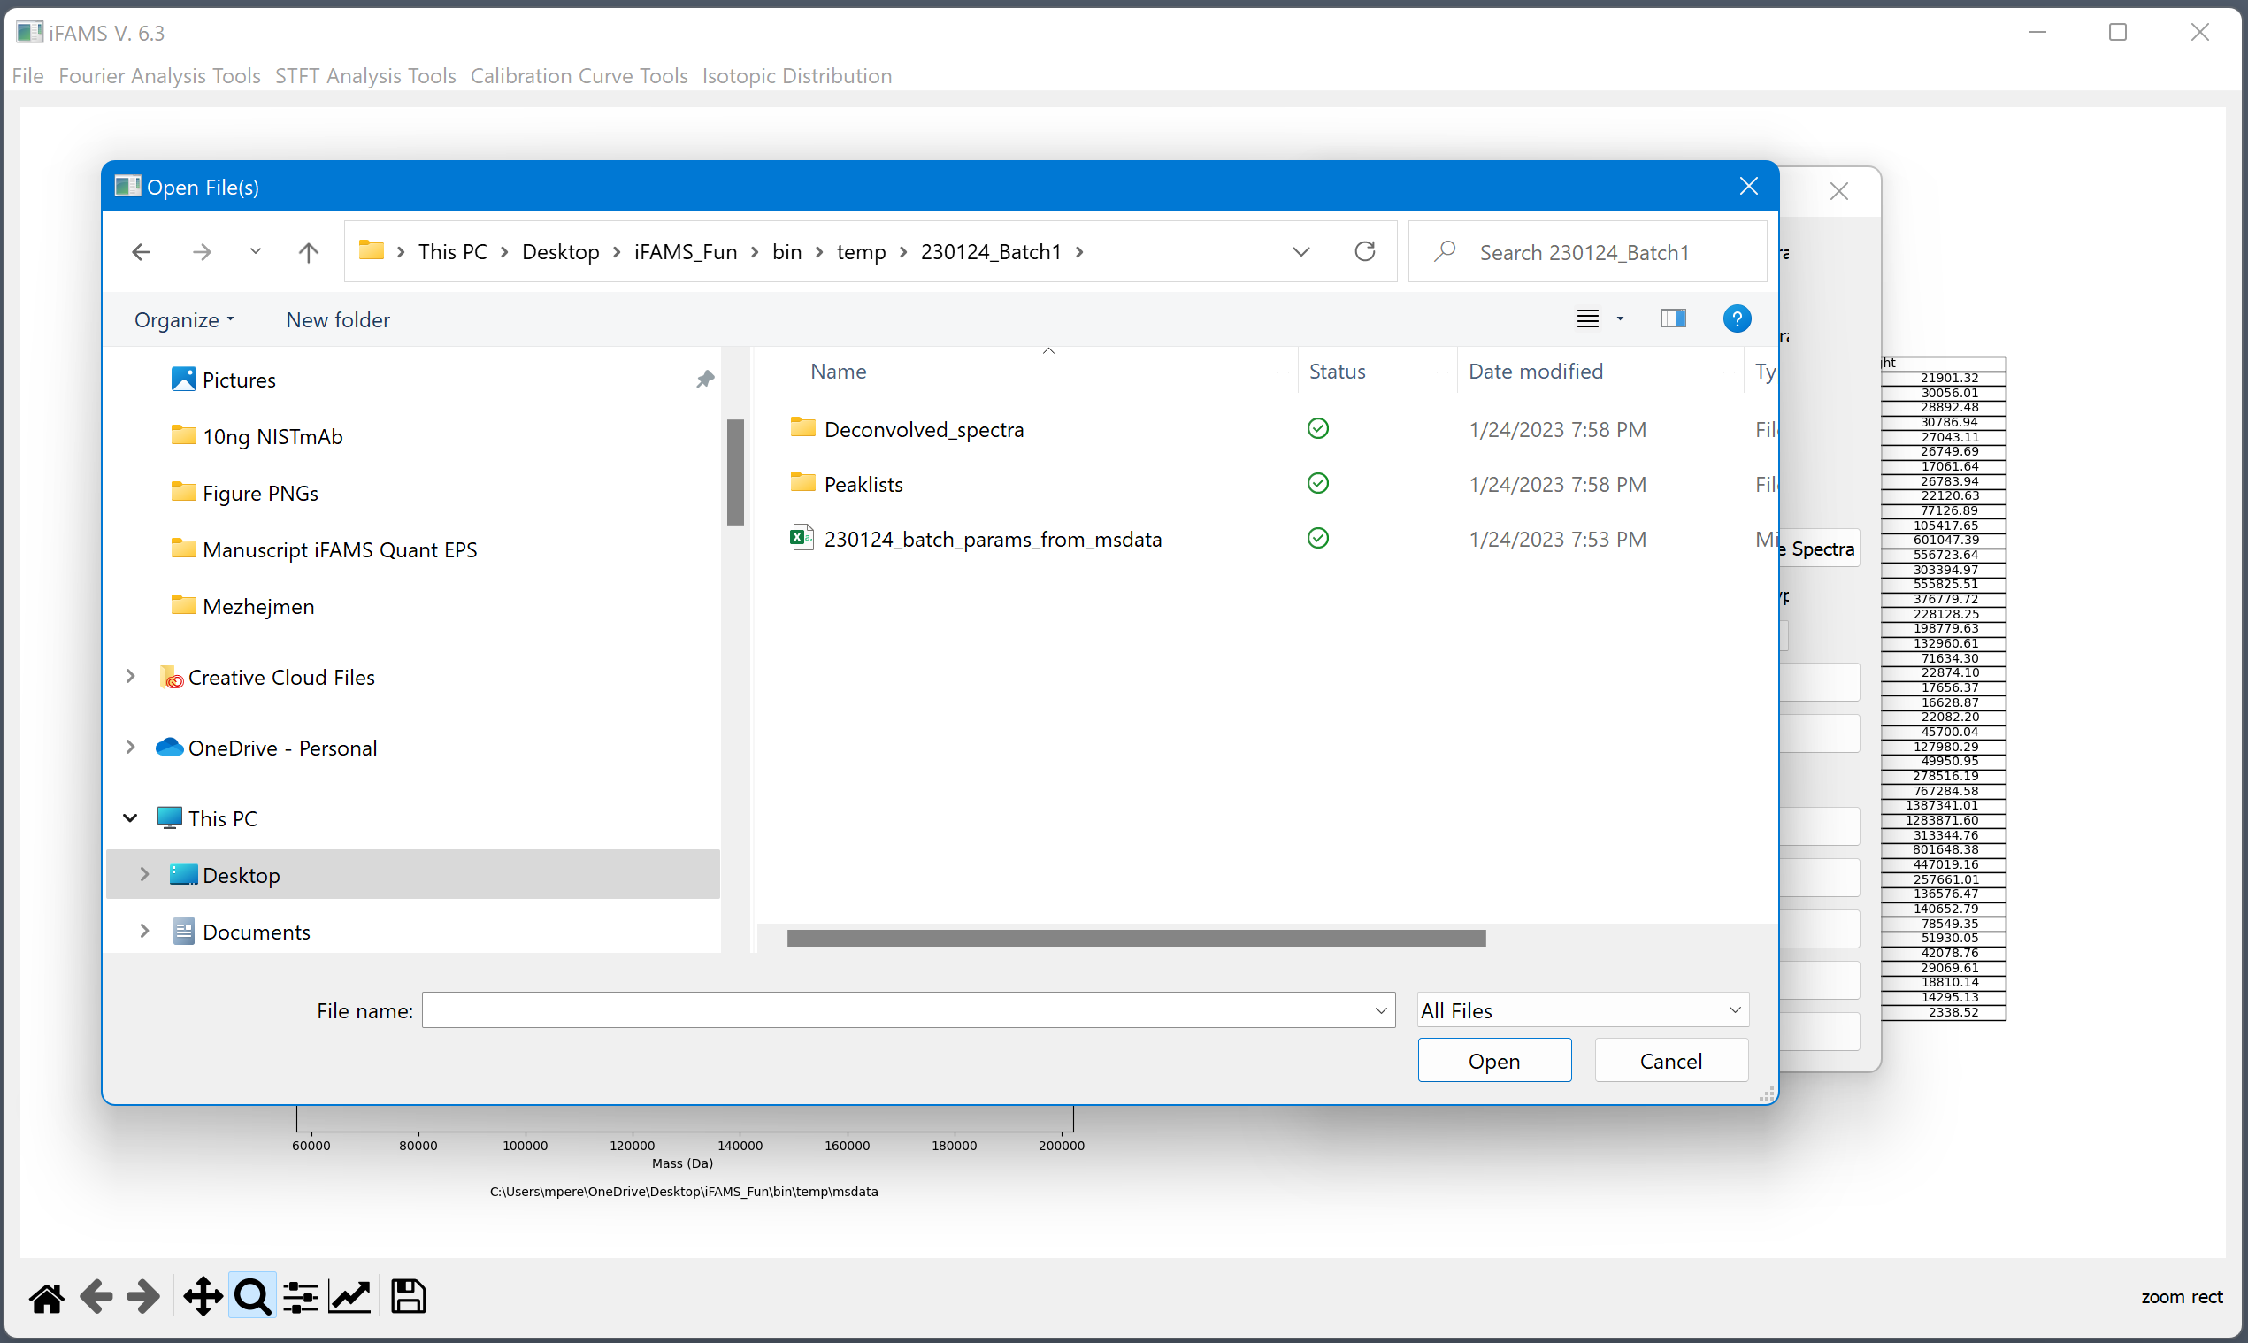
Batch folder should be located with the processed file and labeled with the date and batch number.

Slide 47
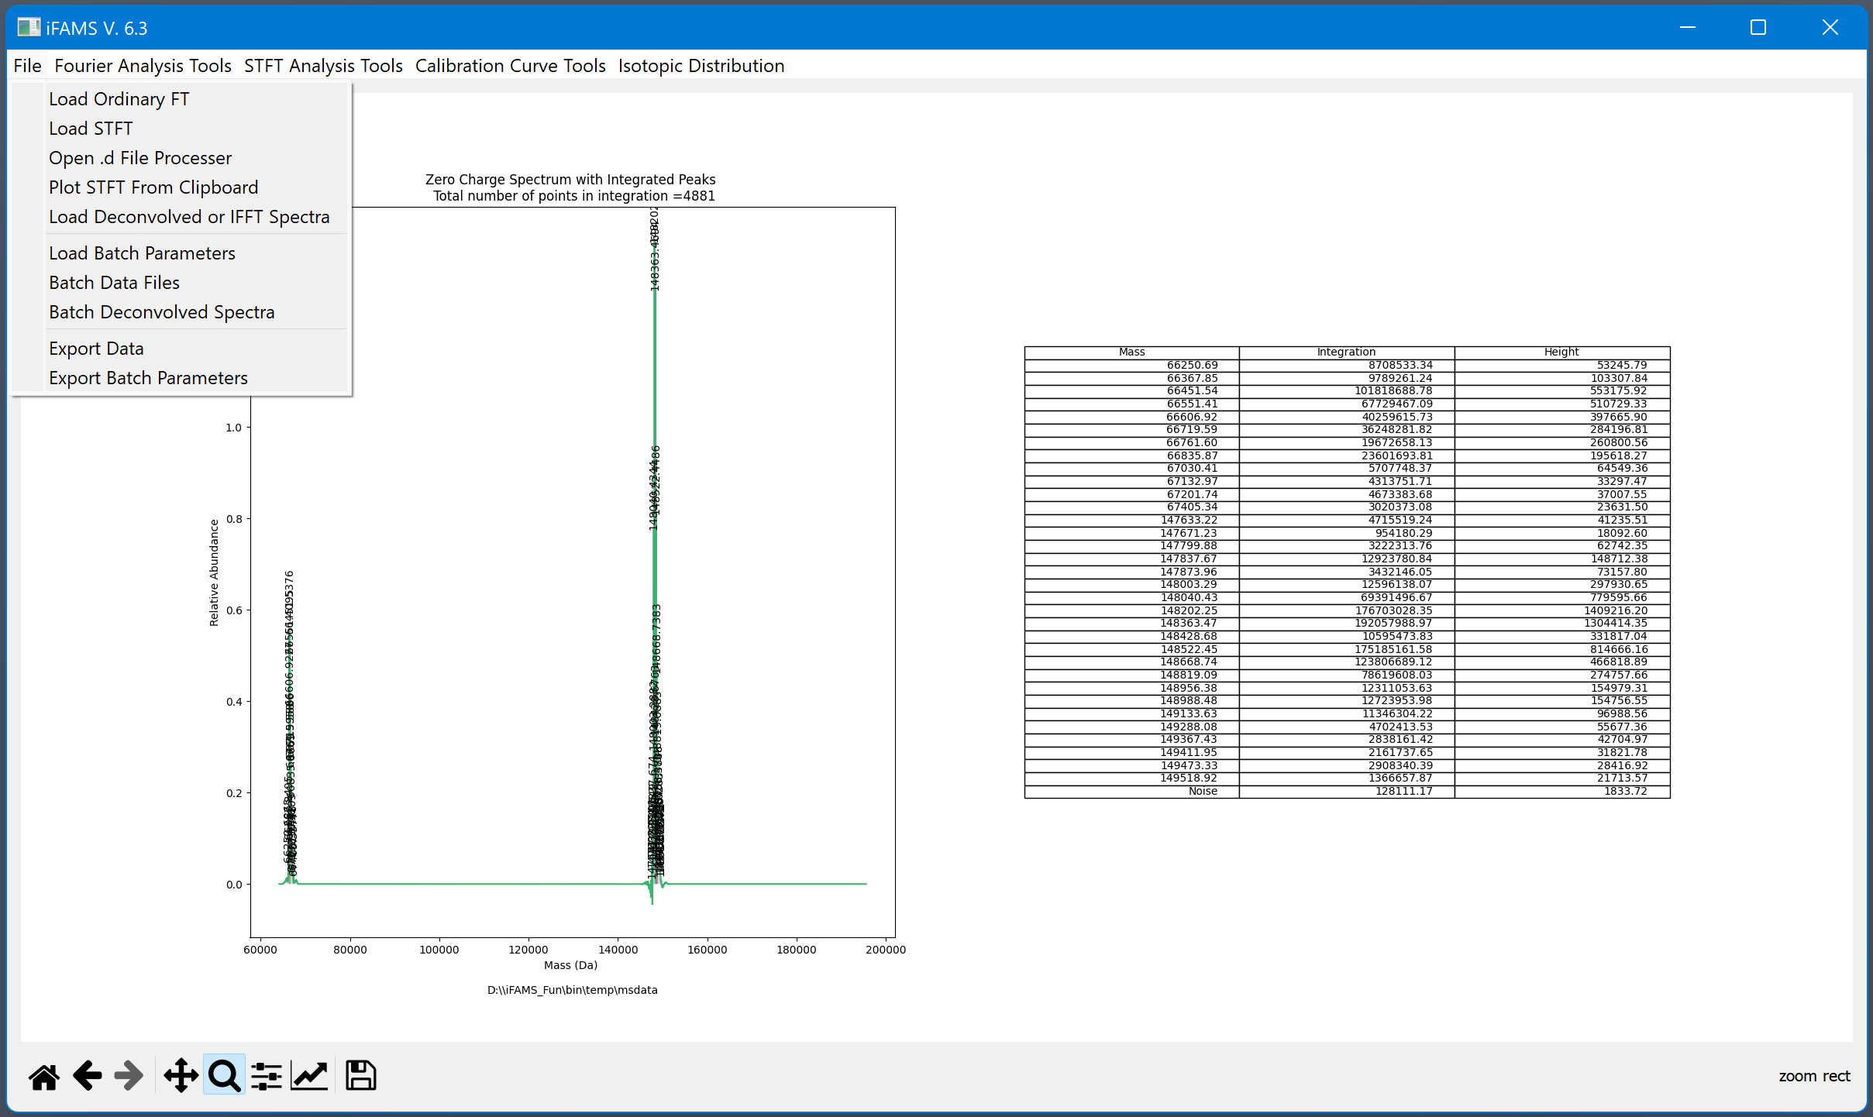
Loading one deconvolved spectrum will also display the integration and the charge-corrected inverse FT spectra.
Loading multiple deconvolved spectra will just overlay each combined zero-charge spectrum.
Loading IFFT spectra will display the original MS data and overlay the inverse FT spectra labeled with the assigned charge.

Slide 48
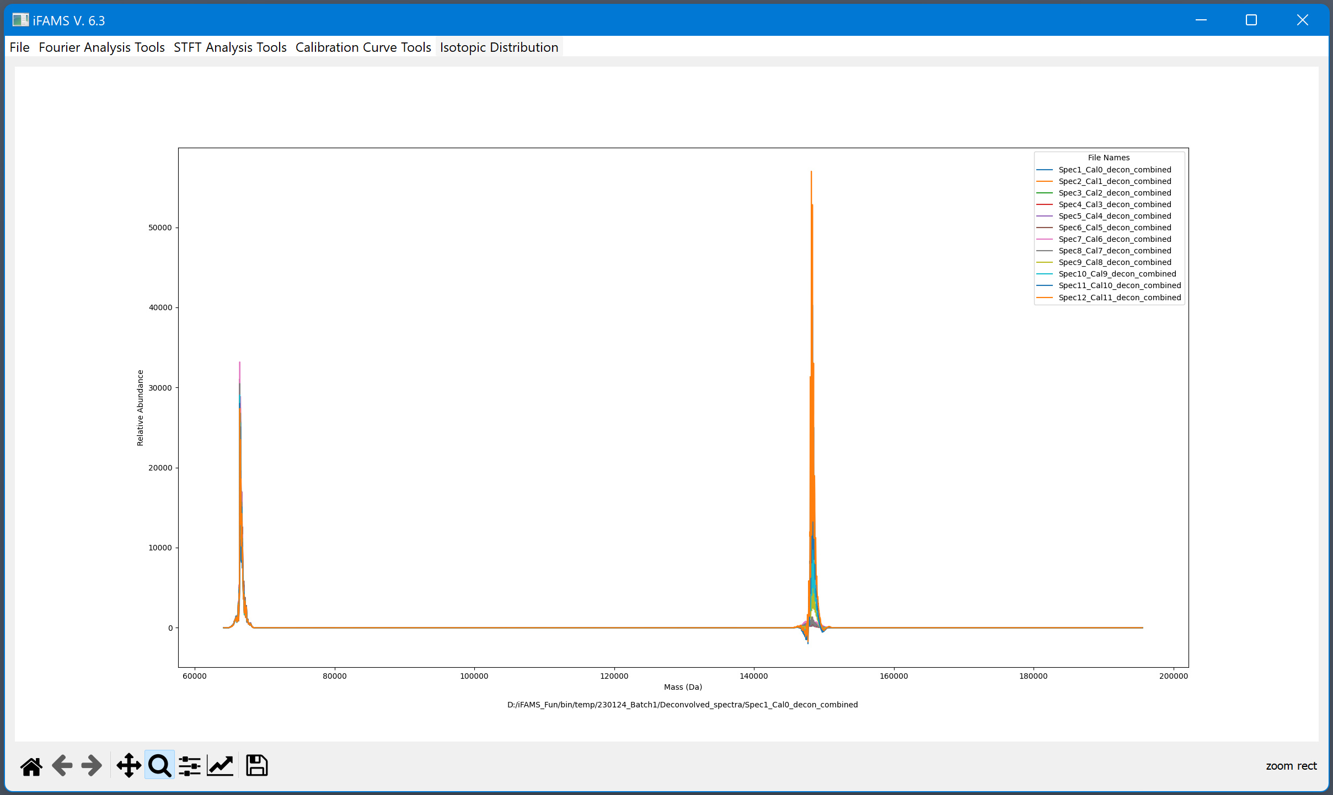
Overlaying the batched deconvolved spectra…

Slide 49
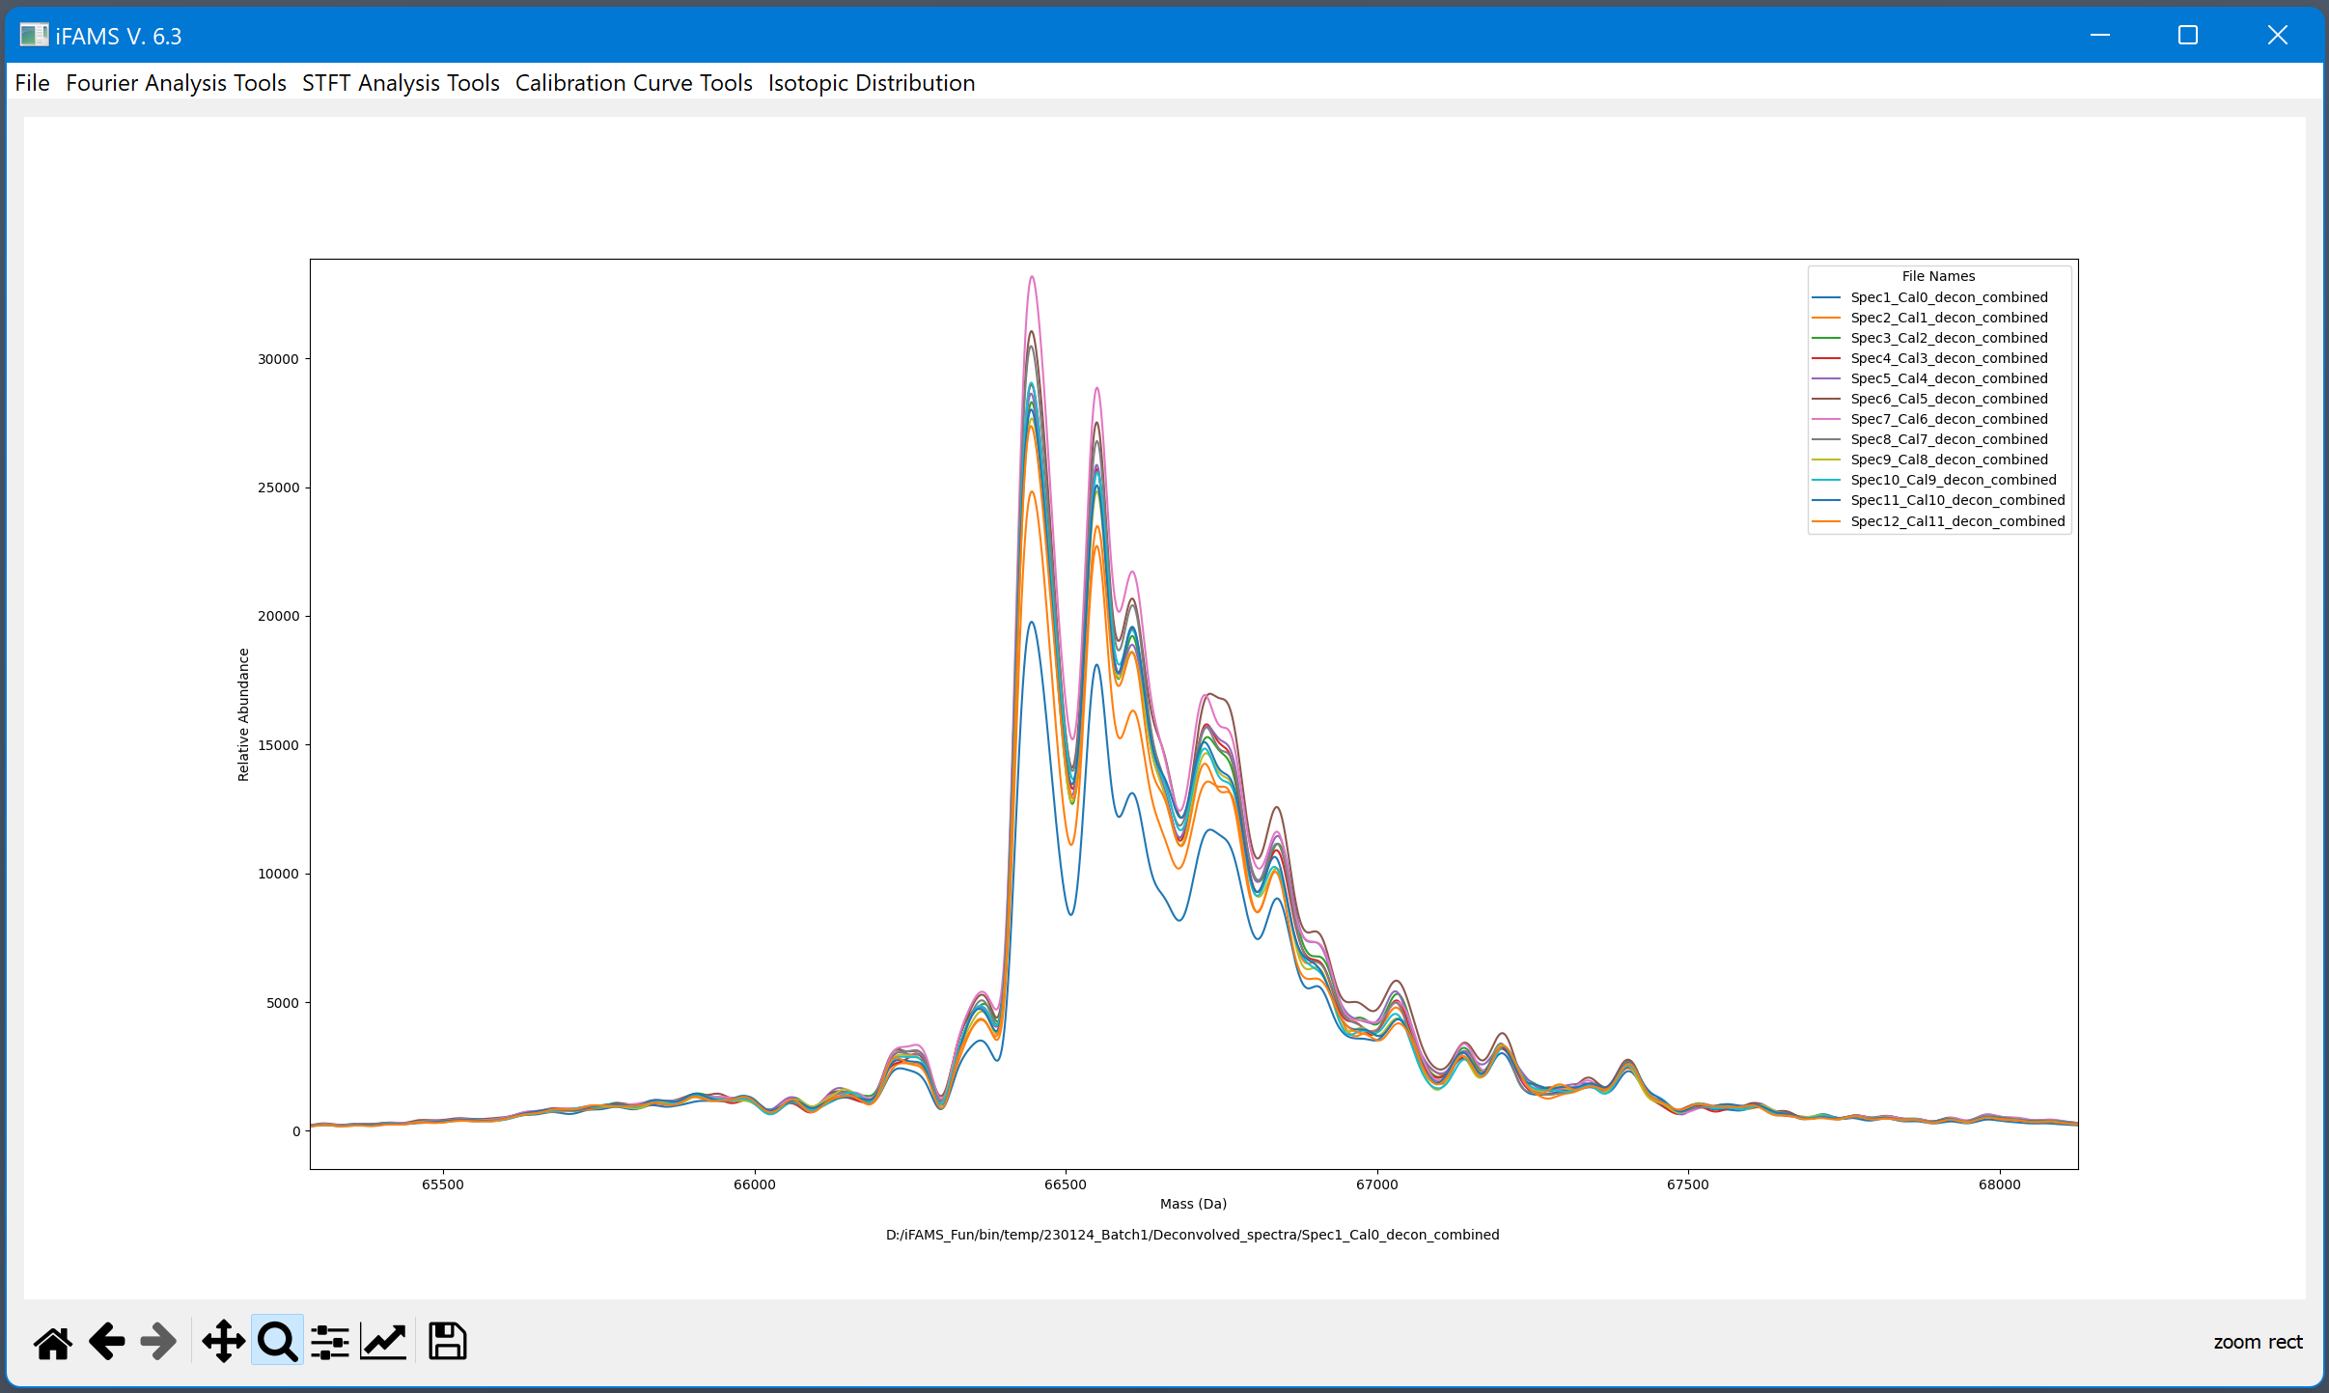
BSA internal standard
10 ng/µL

Slide 50
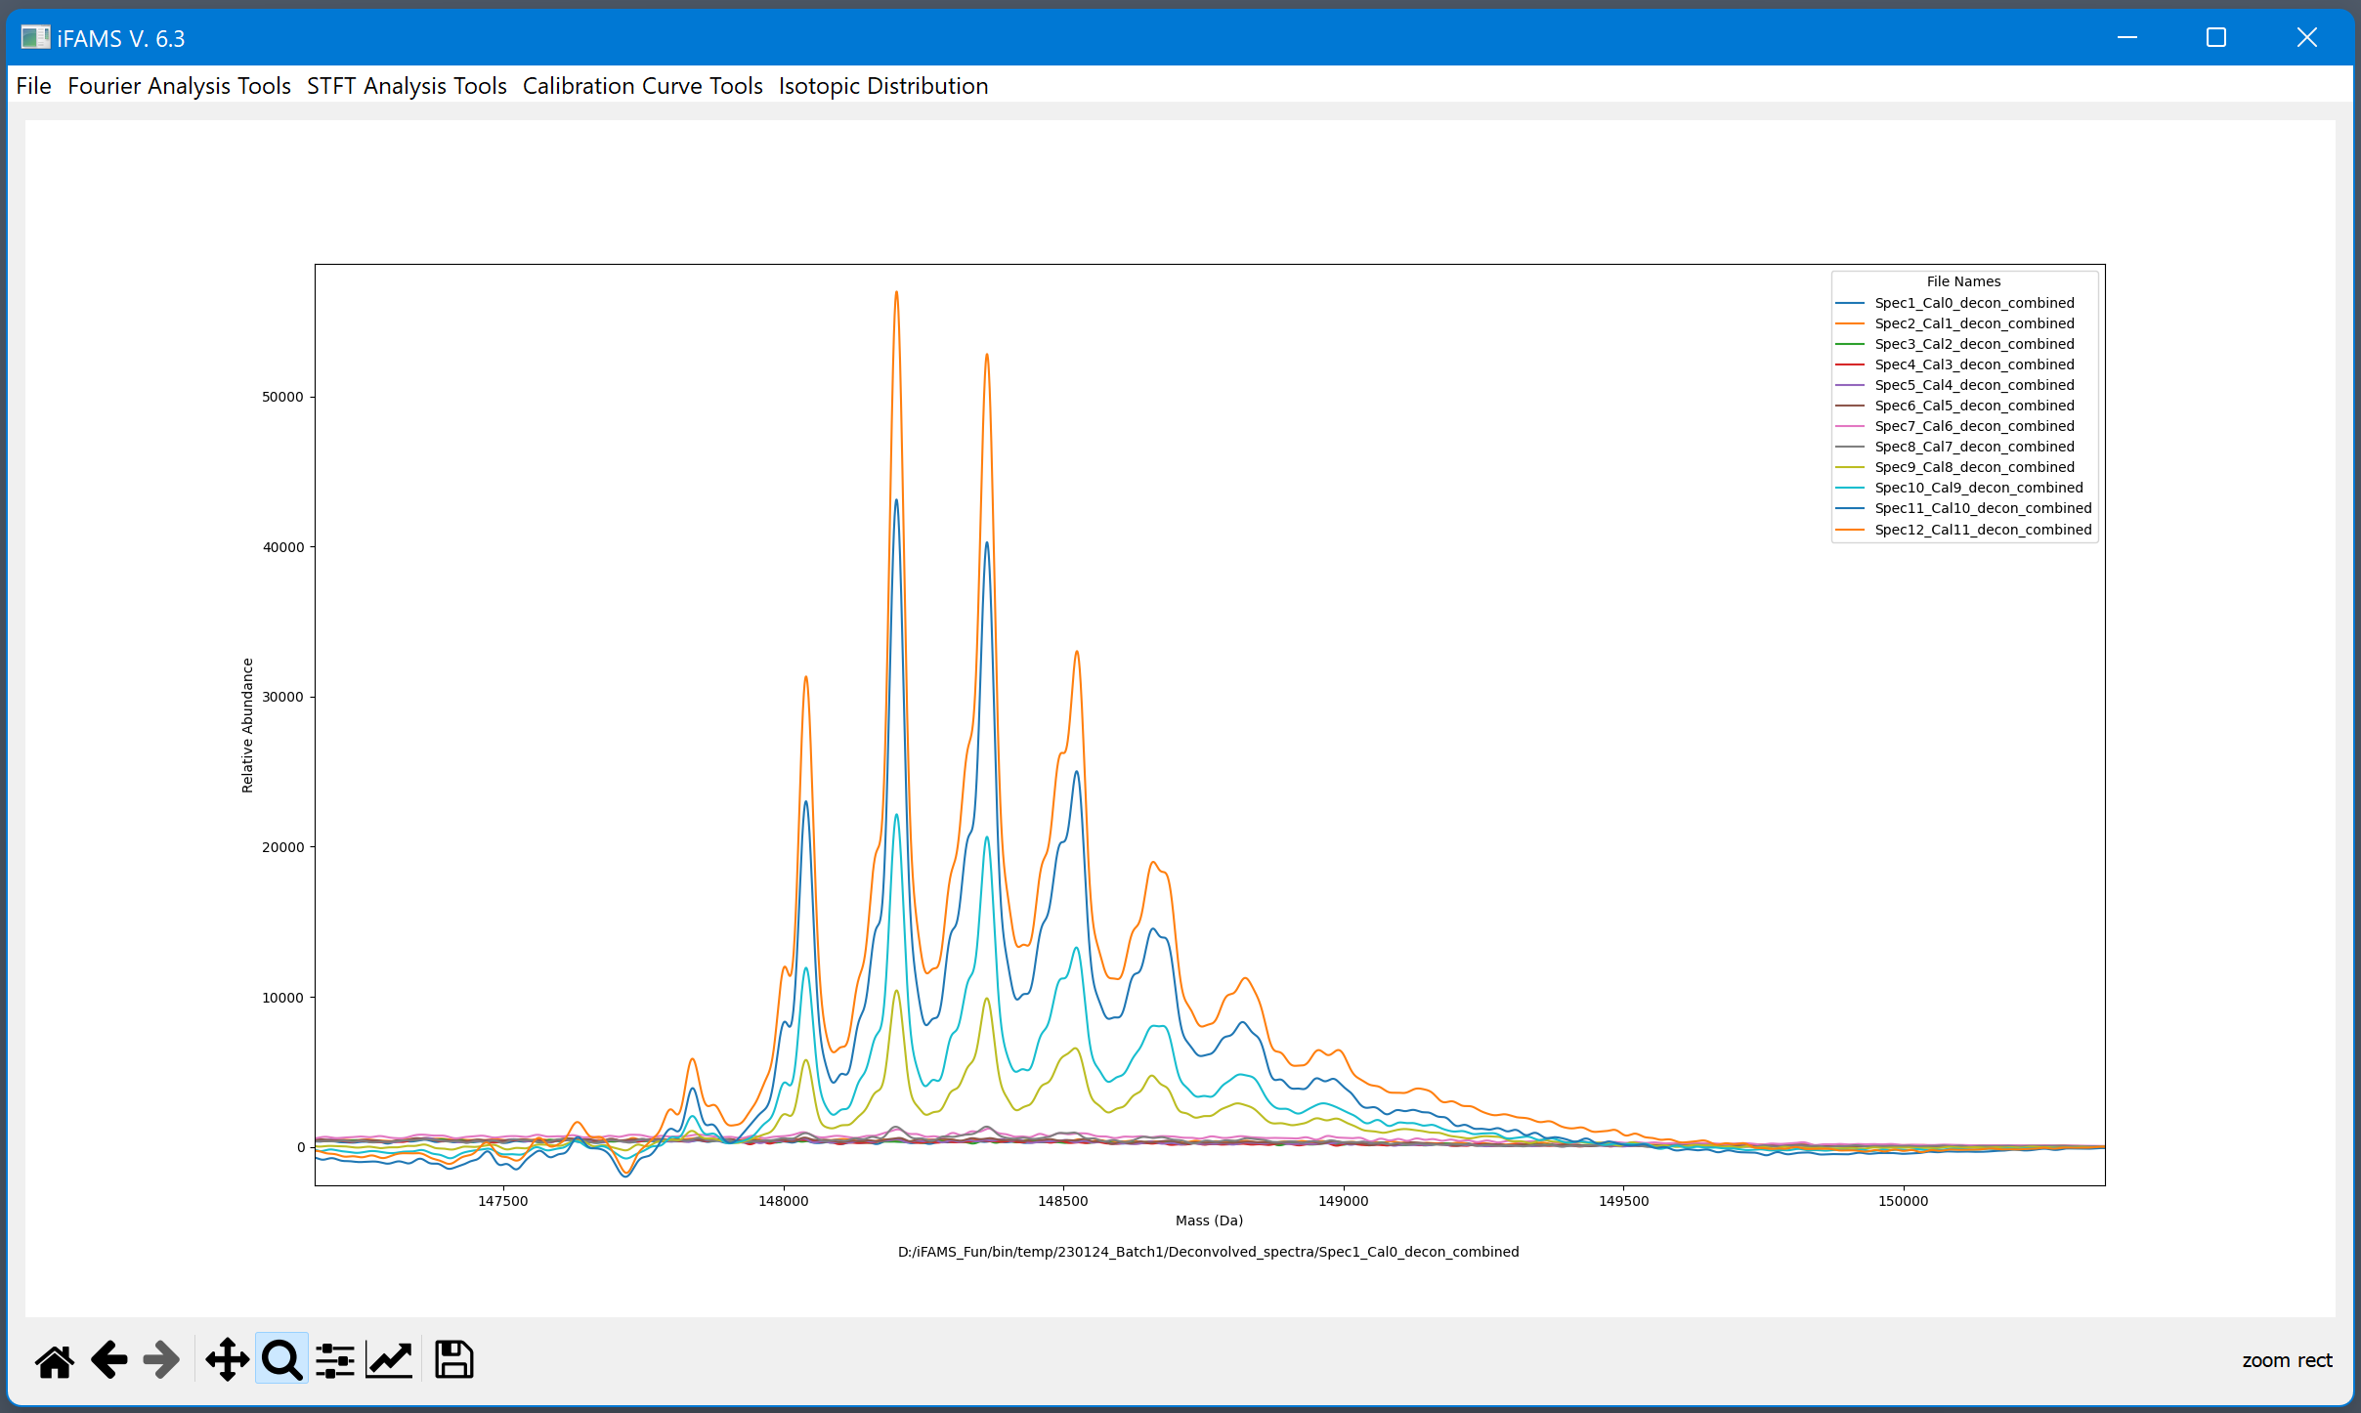
NIST mAb calibrant
Cal vs. Conc (ng/uL)
0 = 0
1 = 0.005
2 = 0.01
3 = 0.02
4 = 0.05
5 = 0.1
6 = 0.2
7 = 0.4
8 = 2
9 = 4
10 = 8
11 = 10

Slide 51
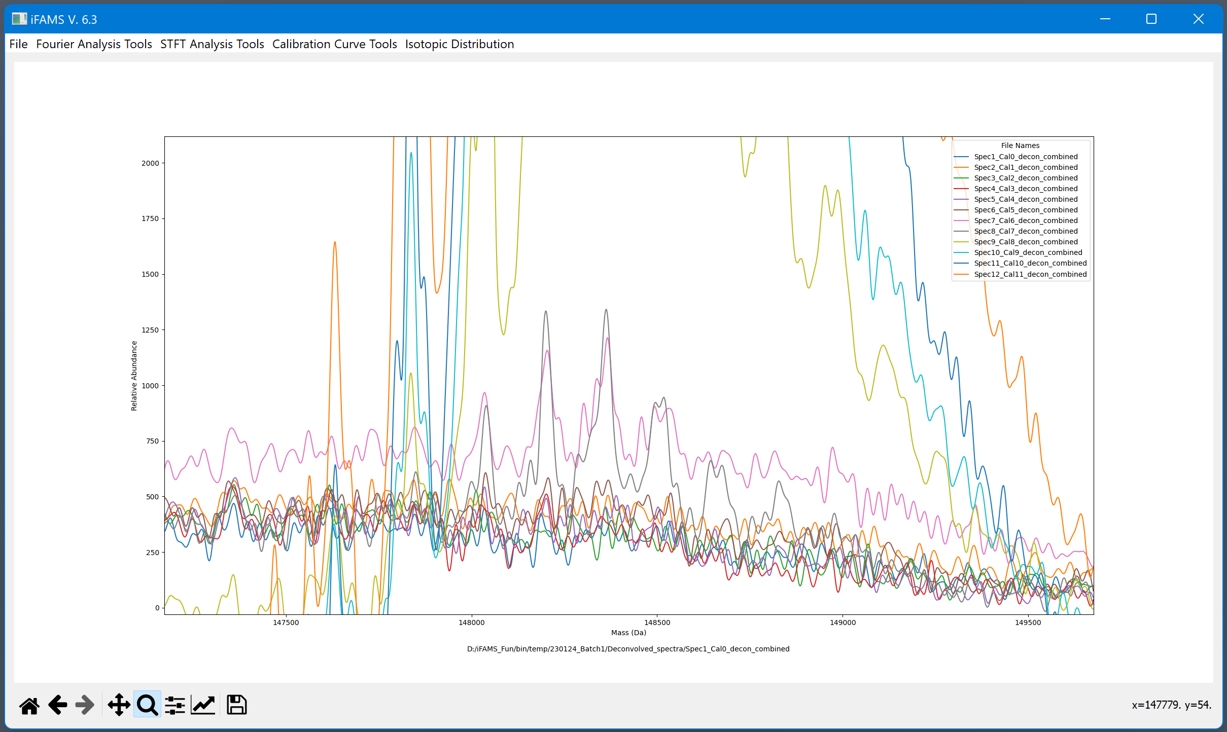
NIST mAb calibrant zoomed in…
Cal vs. Conc (ng/uL)
0 = 0
1 = 0.005
2 = 0.01
3 = 0.02
4 = 0.05
5 = 0.1
6 = 0.2
7 = 0.4
8 = 2
9 = 4
10 = 8
11 = 10

Slide 52
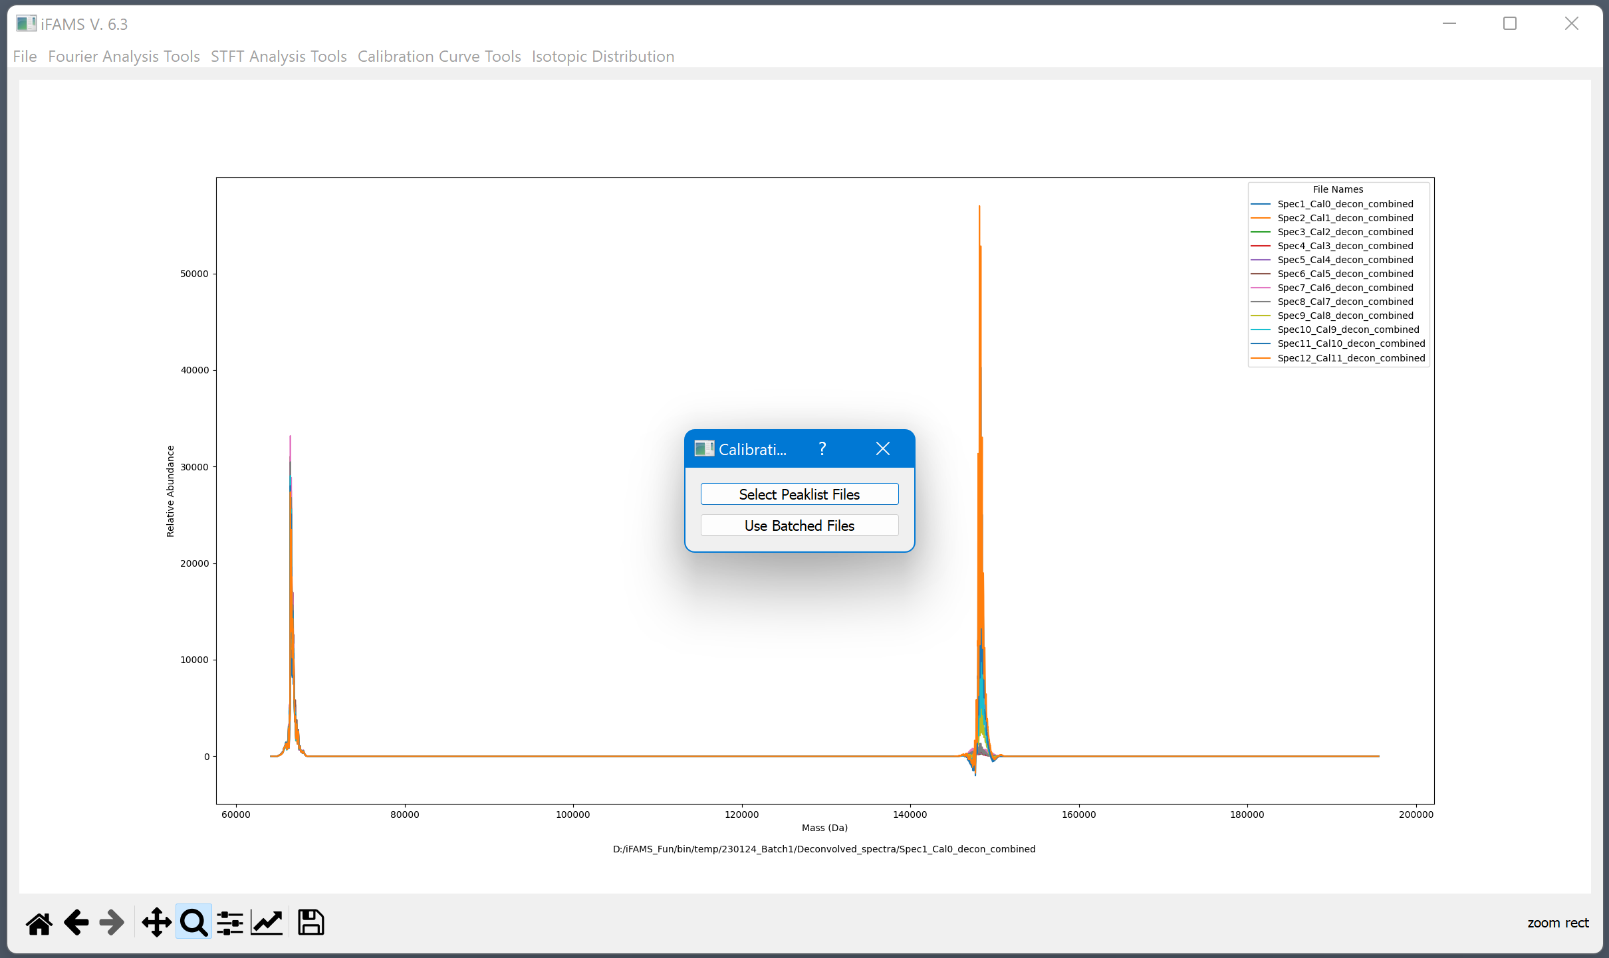
Generating a calibration curve

Slide 53
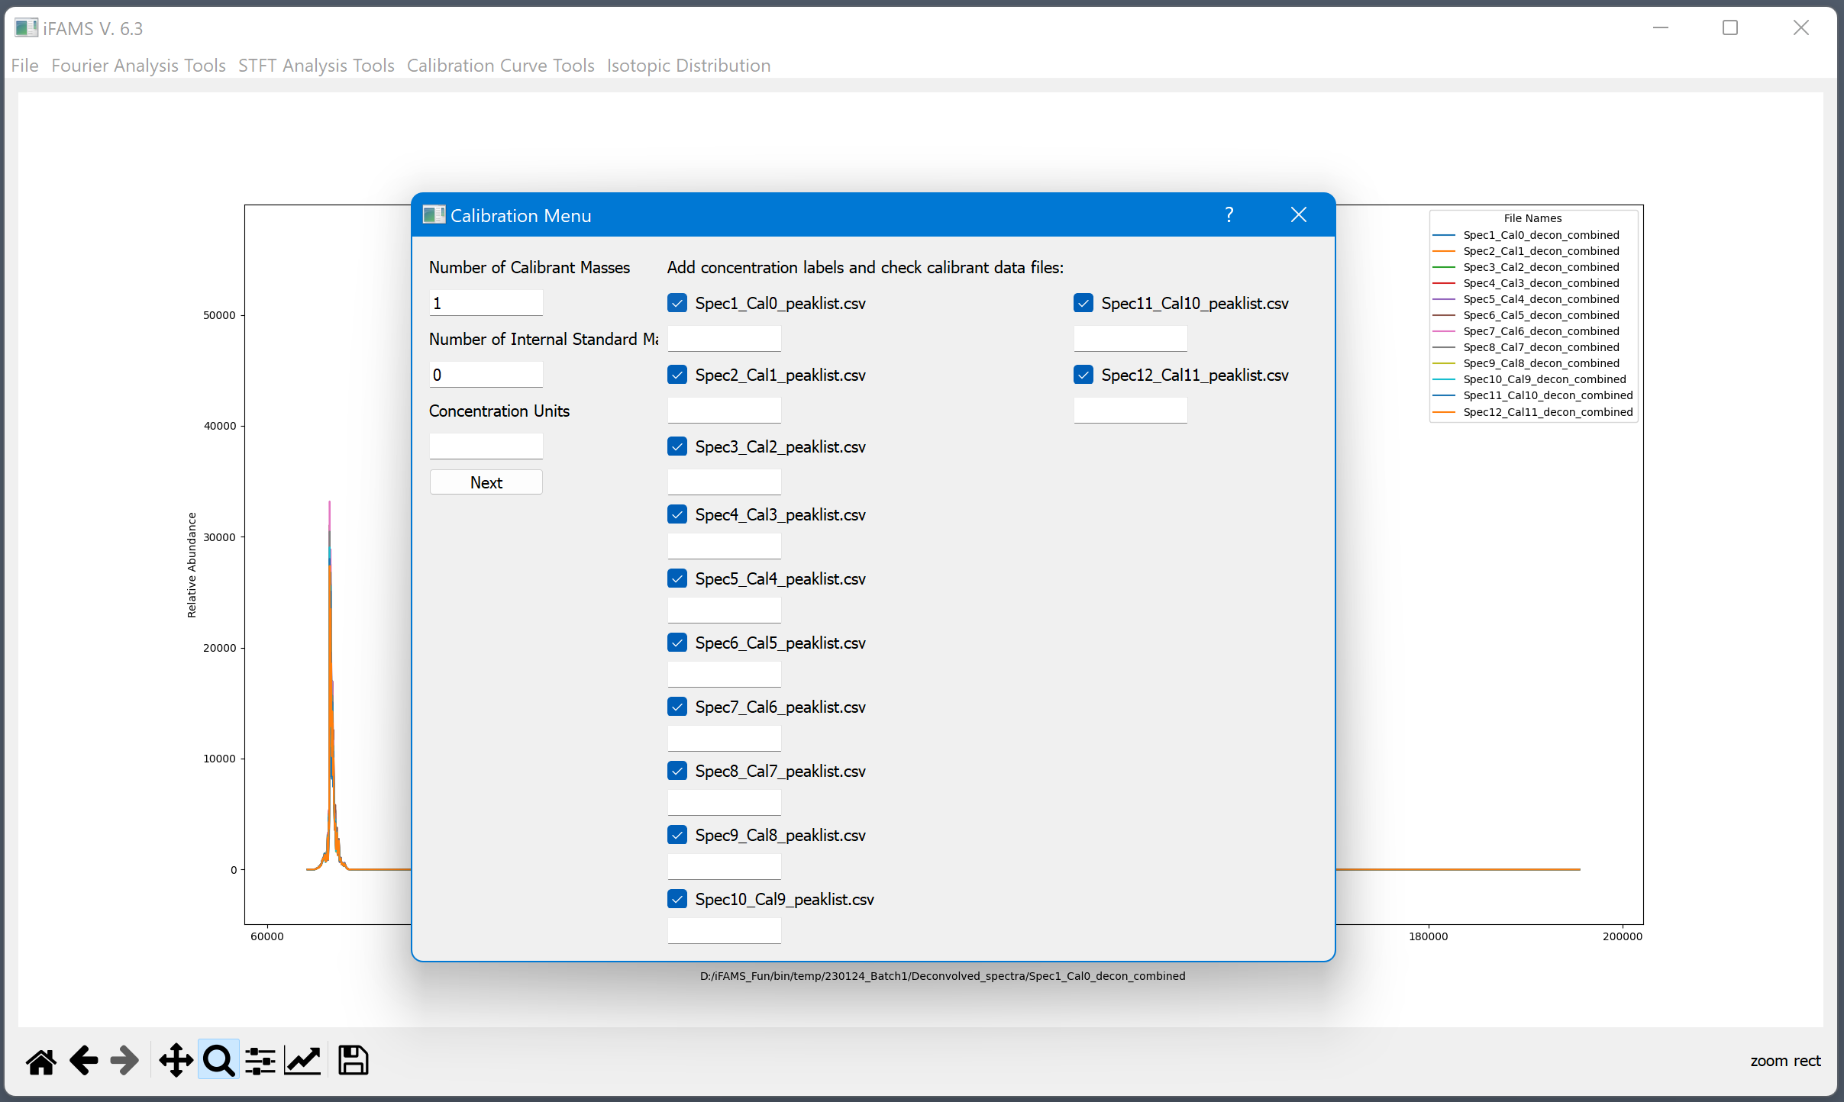

Slide 54
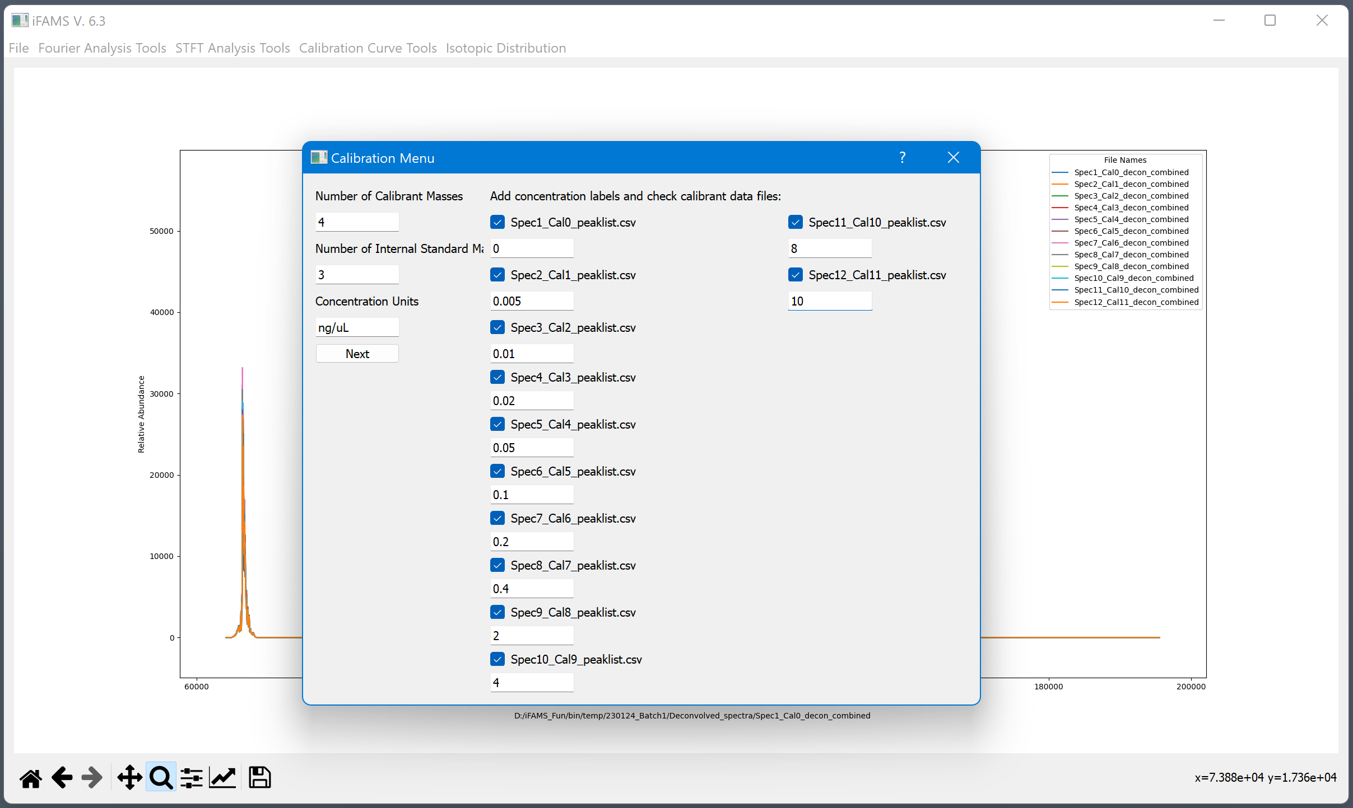

Slide 55
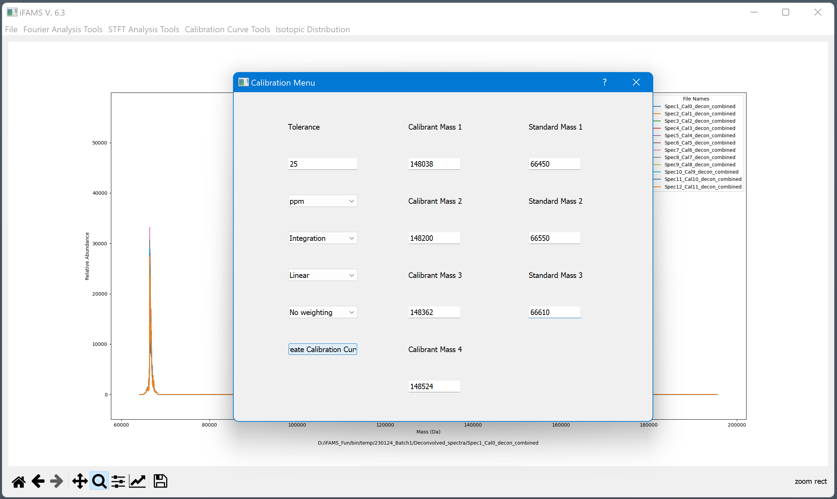
Tolerance units can be toggled between Da and ppm.
Signal type can be toggled between peak integration and height.
Curve type can be switched between linear, quadratic, and logistic.
There are also various weighting options.
These options can be adjusted later as well.
(Create Calibration Curve)

Slide 56
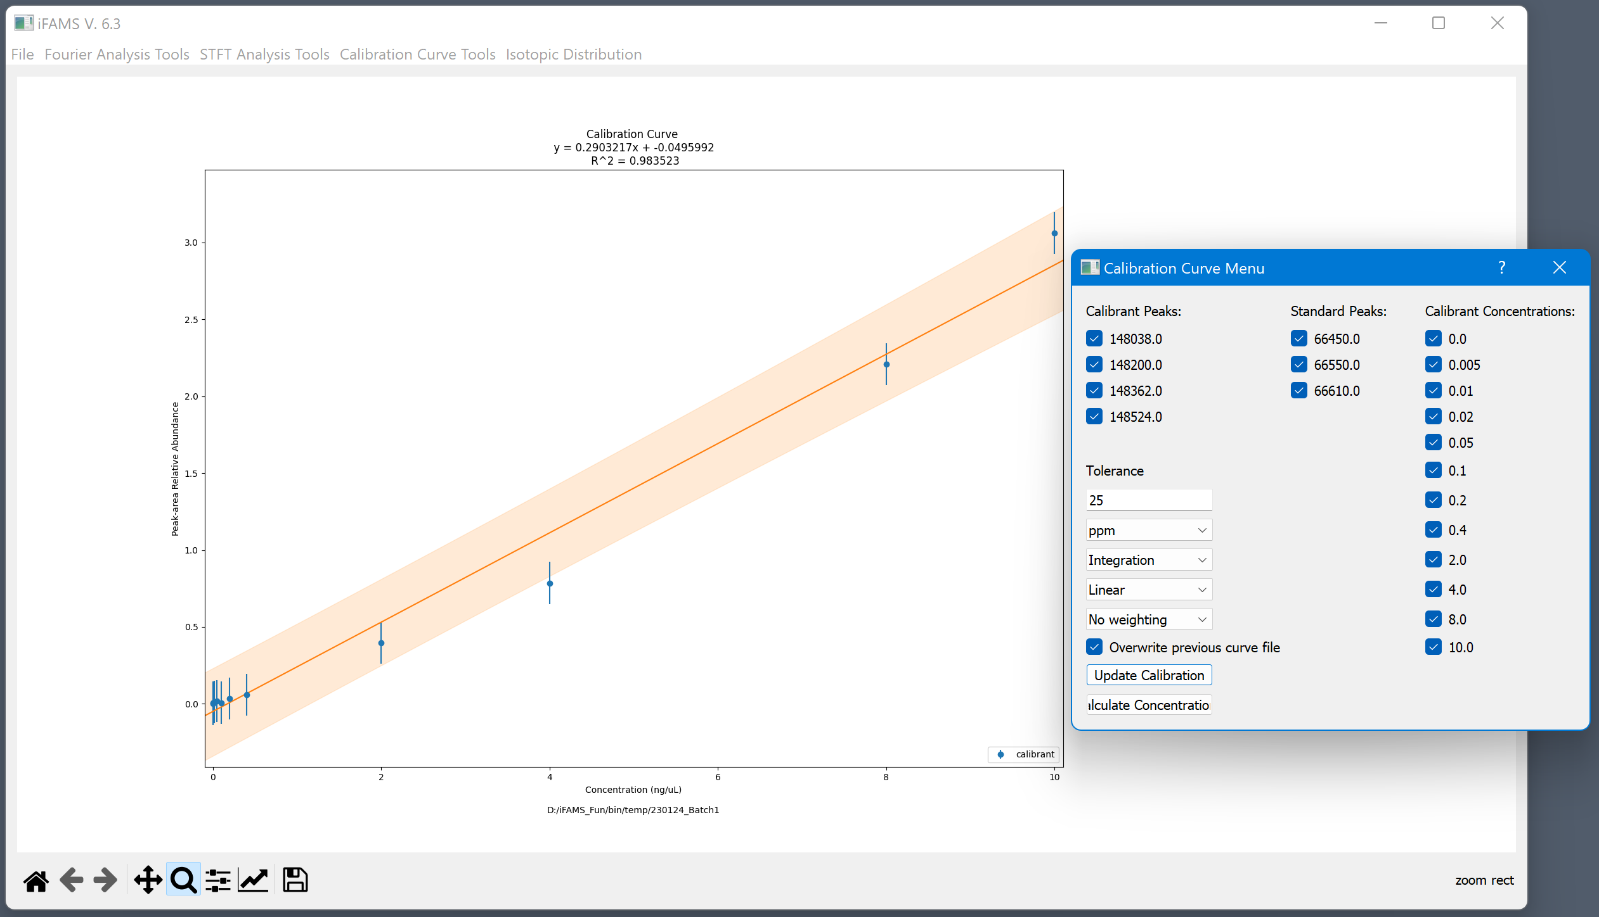
Calibrant masses can be easily toggled

Slide 57
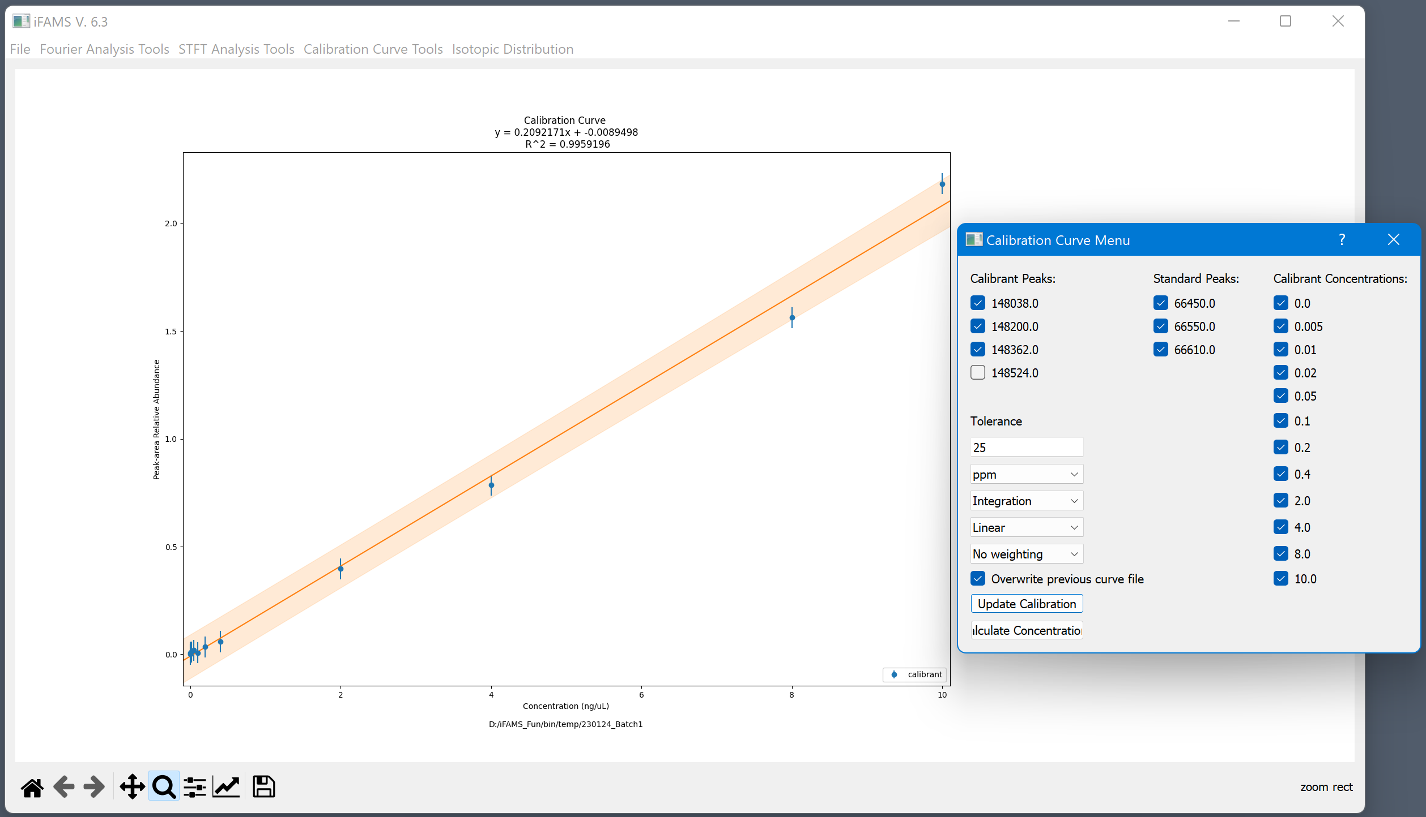
Internal standard masses can also be easily toggled or turned off entirely

Slide 58
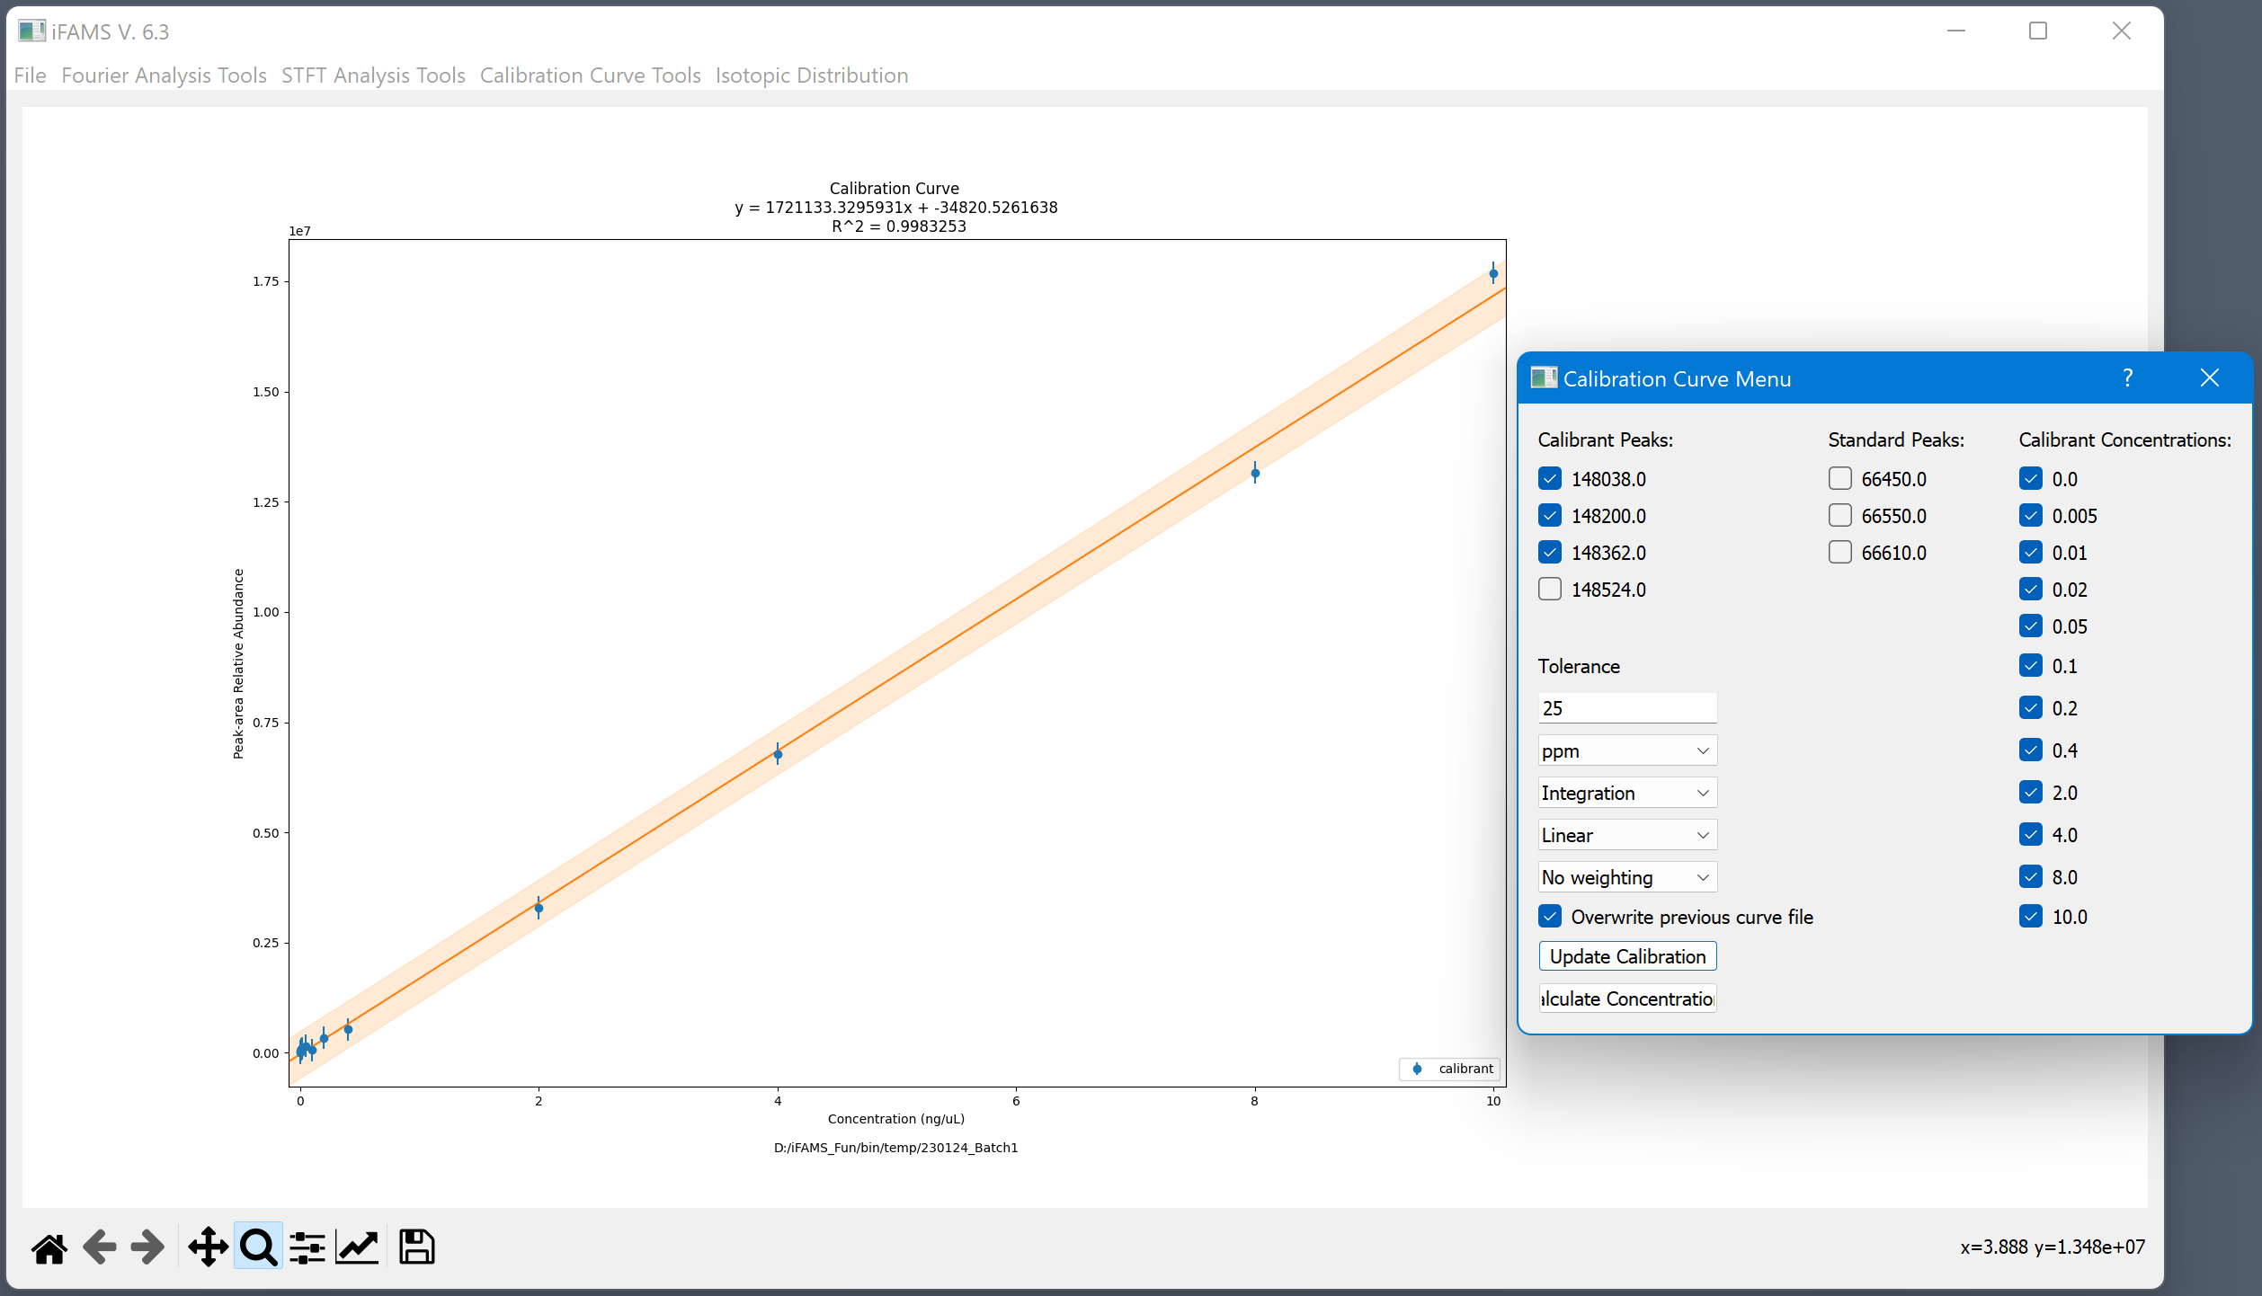
(Calculate Concentrations)
Unknowns and quality controls can be plotted against the curve to calculate their concentrations.

Slide 59
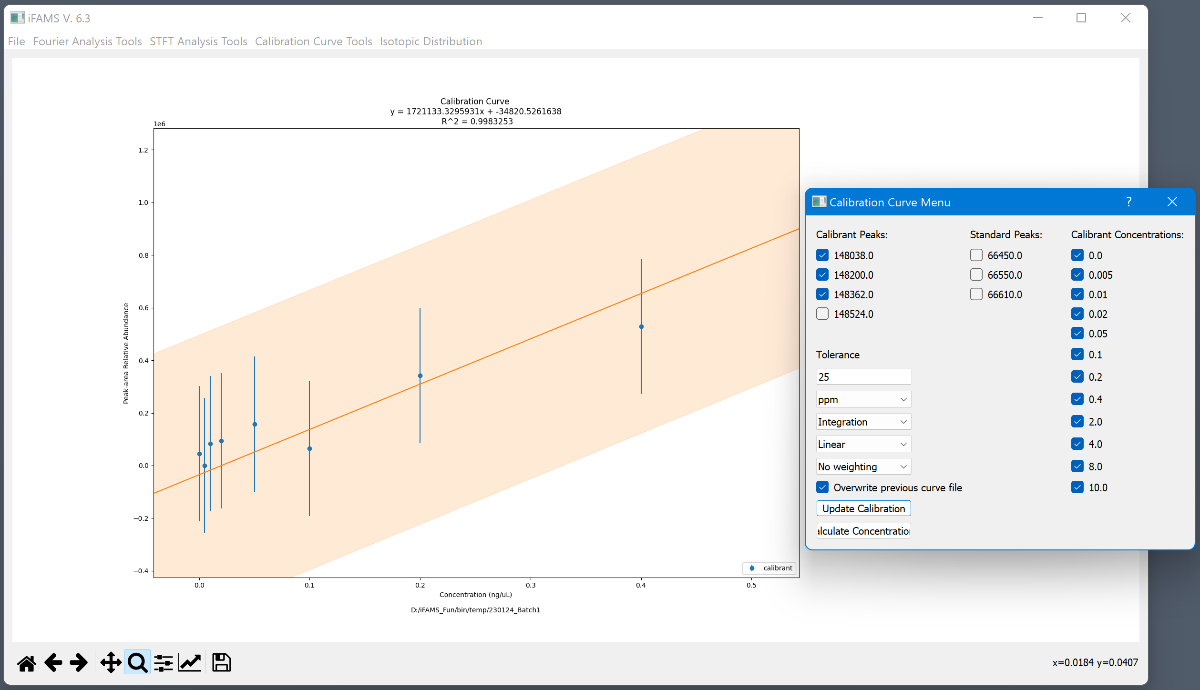
Zoomed in on the low concentrations…

